Slide 1
Practical Natural Language Processing
Julia Proskurnia
me@juliapro.xyz
July, 2019

Slide 2
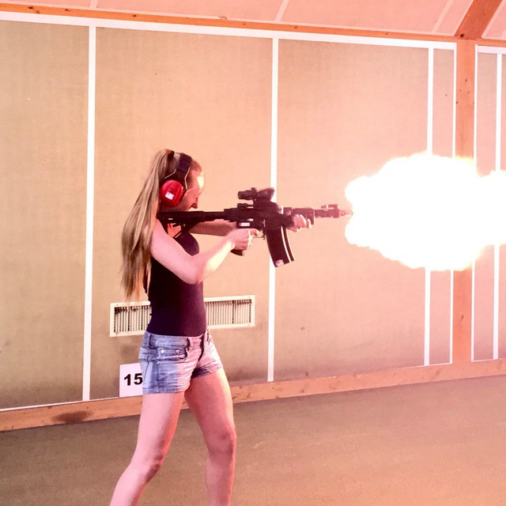


About me, myself, I
[BA, MS] NTUU KPI (Optimization, Neural Networks, Time Series Prediction)
[MS] EMDC, Barcelona, Stockholm (Distributed Systems)
[PhD] EPFL, Lausanne (Profiling, Modeling and Facilitating Online Activism)
Google, Zurich (Gmail Smartcompose boilerplate Personalization, Gmail Subject Smartcompose, etc.)
Google, Zurich (Next Generation Assistant)

Slide 3
Course Expectations?
Would be more useful for people less familiar with NLP.
Familiarity with Machine Learning concepts would help, but we will cover that briefly as well.
Notes:
familiarity with NLP?
familiarity with ML?

Slide 4
What this course is not about!
Going over some fancy math for FEW particular algorithms
Coding scalable solutions
Go into the wild and write DNN architectures left and right :)
Not solely Deep Learning in NLP
But…
You would get some practical starting points on many of the NLP directions
Lots of reference points
Buzzwords :)

Slide 5
Overview for what to expect
Intro to NLP problems
Intro to the course setup
Text preprocessing and annotations
N-Gram extraction, TF-IDF
Document classification
Word Embeddings
Document classification with embeddings
Topic modeling, clustering
Intro to entity extraction
Intro to sequence modeling, deep learning (CNN, LSTM)

Slide 6
Introduction to NLP problems

Slide 7
Structure of the Introduction
What is Natural Language
Examples, applications, a few demos
Typical NLP tasks
Evaluation and metrics
The source of data or data collection

Slide 8
Natural Language Processing (or NLP)
Main objective:
program computers to process and analyze large amount of natural language data.
Notes:
https://en.wikipedia.org/wiki/Natural_language_processing
Related concepts: Computational Linguistics, Natural Language Understanding, Text Mining

Slide 9
What is Natural Language?
"Natural" because evolved naturally, in contrast with Formal Languages.
Features of natural language:
Use of shared knowledge
Time flies like an arrow.
Play rolling stones on youtube
Concise, but ambiguous
Remove the stones from the cherries and put them in the pie.
The hunter shot the tiger; his wife too.
Unlimited expressive power
She was eating a fish with (bones, anger, some friends, a fork)
Congratulations! Great job!
Notes:
Natural language is a method of human communication, either spoken or written, which typically
contains words that are structured in some conventional way.
Conciseness
The student gave his homework to the professor who told him that it could have been better.
The student gave the homework of the student to the professor. The professor told the student that the homework of the student could have been better.
Unlimited expressive power (Representation)
Logical expressions of any order.
Earth is curved - "curved_earth = TRUE"
All politicians lie. - For any x, politician(x) -> lier(x), etc
Shared knowledge
I gave him a nice pen.
Scenario 1: - A "Mont Blanc"? - Yes, like that brand.
Scenario 2: - How large is it? - To the moon and back.
There exist Formal and Natural languages.
Formal languages are by construction explicit and non-ambiguous.
Natural languages are in essence implicit and ambiguous (examples)
When a computer has to deal with the textual data, it actually faces the following:
Human language is very high dimensional and sparse.
Depending on the representation and the language, for a machine, natural language consists of a
huge number of words, and even greater number of possible word-like features
(parts of speech, grammatical variations of the language, various languages, etc.)
Moreover, for most of those, we simply do not have enough data to give to the machine or even worse,
the same words mean multiple things.
Human language is redundant and ambiguous.
As we have discussed earlier, human language is unnecessarily redundant.
There are an enormous number of ways to describe the same thing.

Slide 10
Challenges for NLP
Implicit -> allows conciseness (but potentially ambiguous)
Unlimited expressive power -> flexible interpretation rules
(meanings != word as it is written)
Why do we still understand each other? -> A lot of shared knowledge!
Moreover...
Existing words (or linguistic units) change over time.
New words are added.
Language contains errors.
Linguistic units denote an idea or even several.
We have lots of common sense knowledge and understand hierarchical structures in language.
Notes:
Implicit -> allows conciseness (but potentially ambiguous)
Unlimited expressive power -> flexible interpretation rules (so meanings != word as it is written)
Why do we still understand each other? -> A lot of shared knowledge!
Moreover...
Existing words (or linguistic units) change over time.
New words are added.
Language contains errors.
Linguistic units denote an idea or even several.
We have lots of common sense knowledge and understand hierarchical structures in language.

Slide 11
Challenges for NLP
Full understanding of Natural Language is difficult
Similar to understanding / modeling the full world knowledge, needs full-capacity AI
Natural languages is highly dimensional and sparse
There are millions of words and most of them are very rare
Internationalization requires prior within-domain knowledge
Many languages with scarce resources
Notes:
Implicit -> allows conciseness (but potentially ambiguous)
Unlimited expressive power -> flexible interpretation rules (so meanings != word as it is written)
Why do we still understand each other? -> A lot of shared knowledge!
Moreover...
Existing words (or linguistic units) change over time.
New words are added.
Language contains errors.
Linguistic units denote an idea or even several.
We have lots of common sense knowledge and understand hierarchical structures in language.

Slide 12
Text to annotations
annotations
problem
a label (e.g. spam / not spam)
classification
text
a numerical value (e.g. positive strength)
regression
annotations
structured annotation (e.g. a syntax tree)
parsing
label sequence (per words, e.g. part-of-speech tags)
sequence labeling
Notes:
One text document (query, web page) -> preprocessing, parsing, understanding, classification, sequence labeling, summarization, …

Slide 13
Text to another text
new text
problem
from one language to another
translation
text
new text
from question to answer
question-answering
from text to its shortened version
text summarization
text continuation (e.g. SmartCompose)
language modeling
generating text rewrites
paraphrase generation

Slide 14
Text collection to useful info
info
problem
find most representative texts, generating summary
summarization
Text collection
useful info
identify facts / events (e.g. 'X is a capital of Y')
information extraction
find groups of similar texts (e.g. for deduplication)
clustering
identify different patterns (e.g. temporal or similarity-wise)
visualization
Notes:
Set of documents -> Summarization, Information Extraction, Clustering, Indexing/Ranking, …

Slide 15
Text to text collection
output
problem
text
all relevant documents (e.g. search results for a query)
retrieval
Text collection
select a top doc from a collection (e.g. knowledge panel)
ranking
Notes:
"onebox" - is the top result aiming to directly give user an answer.

Slide 16
Space of NLP problems (non-exhaustive!)
Text collection
summarization
text
classification
annotations
information extraction
regression
useful info
clustering
parsing
visualization
sequence labeling
translation
text
retrieval
text
new text
question-answering
ranking
text summarization
Text collection
language modeling
paraphrase generation

Slide 17
Applications and Examples
More examples in the colab...

Slide 18
Typical NLP tasks
Classification: Classifying documents into particular categories (giving labels).
Regression: Predict numerical values
Clustering: Separating documents into non- overlapping subsets.
Ranking: For a given input, rank documents according to some metric.
Association rule mining: Infer likely associations patterns in data.
Structured output: Parse trees, etc.
Sequence-to-sequence: For a given input/source text, generate output annotations or another text.

Slide 19
Typical NLP Solution Flow
Example: Machine Translation
Formulate a problem statement
Collect the data
Get 'golden' or 'silver' answers
Search for prior resources
Train the model
Evaluate the quality
Iterate
1
2
3
4
5
6
7
sequence-to-sequence generation
within-language texts, aligned text pairs
golden: human-rated or generated,
silver: automatically aligned from Wikipedia
pre-trained text representations,
ready tools for text annotation
(many options)
accuracy, readability, ...
find better representations, more features, better data, etc.
Notes:
Set the research/exploration goal (e.g., how heavy will be the earthquake on a given day)
Make a hypothesis ( e.g., strength of the earthquake is an informative signal)
Collect the data (e.g., collect historical strength of the quakes on each day)
Test the hypothesis (e.g., train a model using the data)
Analyze the results (e.g., are results better than existing systems)
Reach a conclusion (e.g., the model should be used or not because of A, B, C)
Refine hypothesis and repeat (e.g., time of the year could be a useful signal)

Slide 20
Data sources
Raw text data (Unlabeled/Non-annotated):
Pay for it :)
Crawl it from the Web.
Examples: Scrappy, wiki/google crawler
IP addresses, proxies, throttling rates etc.
Twitter (historical or livestream data (< 1% is free))
1% historical tweets from archive.org.
1% via Twitter API.
Keywords (up to 2K) that would match tweets in real time 1% total stream of messages.
News media (News Archive, GDELT)
Wikipedia (Wikipedia dumps)
Notes:
1% historical tweets from archive.org.
Similarly, you can get 1% of full twitter stream as tweets appear via Twitter API.
You can also specify keywords (up to 2K) that would match tweets in real time - as a result you get up to
1% total stream of messages. Note: if you have a not very popular query, you might get all the tweets about it,
but of course, no guarantees.

Slide 21
Annotation of the data and pitfalls
Annotate and/or even generate your data using CrowdSourcing
Crowdflower
MechanicalTurk, etc.
Annotate using auxiliary lexical resources
LIWC a tool that analyses your textual input on the presence of various
"shades" - informal speech; syntactic structures; affect, social words; cognitive, perpetual, biological processes; relativity; personal concerns, etc.
Biases and pitfalls
Biases
Not representative
Noisy data
Incomplete data
Incorrect data
Missing data, etc.

Slide 22
Course practicum setup
We will use colab.research.com.
We will focus on the open-source libraries for NLP to give you easier explanations.
Actions:
Either
Open colabs etc.
OR open the copy of the colab with jupyter notebook [RECOMMENDED if you want to try out dependency parsing]

Slide 23
Preprocessing and data cleaning

Slide 24
Structure of the Preprocessing and Data Cleaning
Tokenization + Sentence Splitting
Normalization / Text cleaning
Stemming/lemmatization, stop-words, punctuations, emojis, domain specifics, etc.
Text Annotation
Part-Of-Speech Tagging
Parse Trees
Notes:
-> to colab now.

Slide 25
Data description: Tweets about natural disasters
DataFrame name: course_data
‘label’ - whether the tweet is relevant to natural disasters or not
‘text’ - raw tweet strings
‘text_tokenized’ tokenized input texts
‘text_tokenized_cleaned’ tokenized and normalized text
document_embeddings - Text representation with word embedding
document_term_matrix - Bag-of-words representation
corpus_tokens - List with list of cleaned tokens of each document
POS exercise in colab

Slide 26
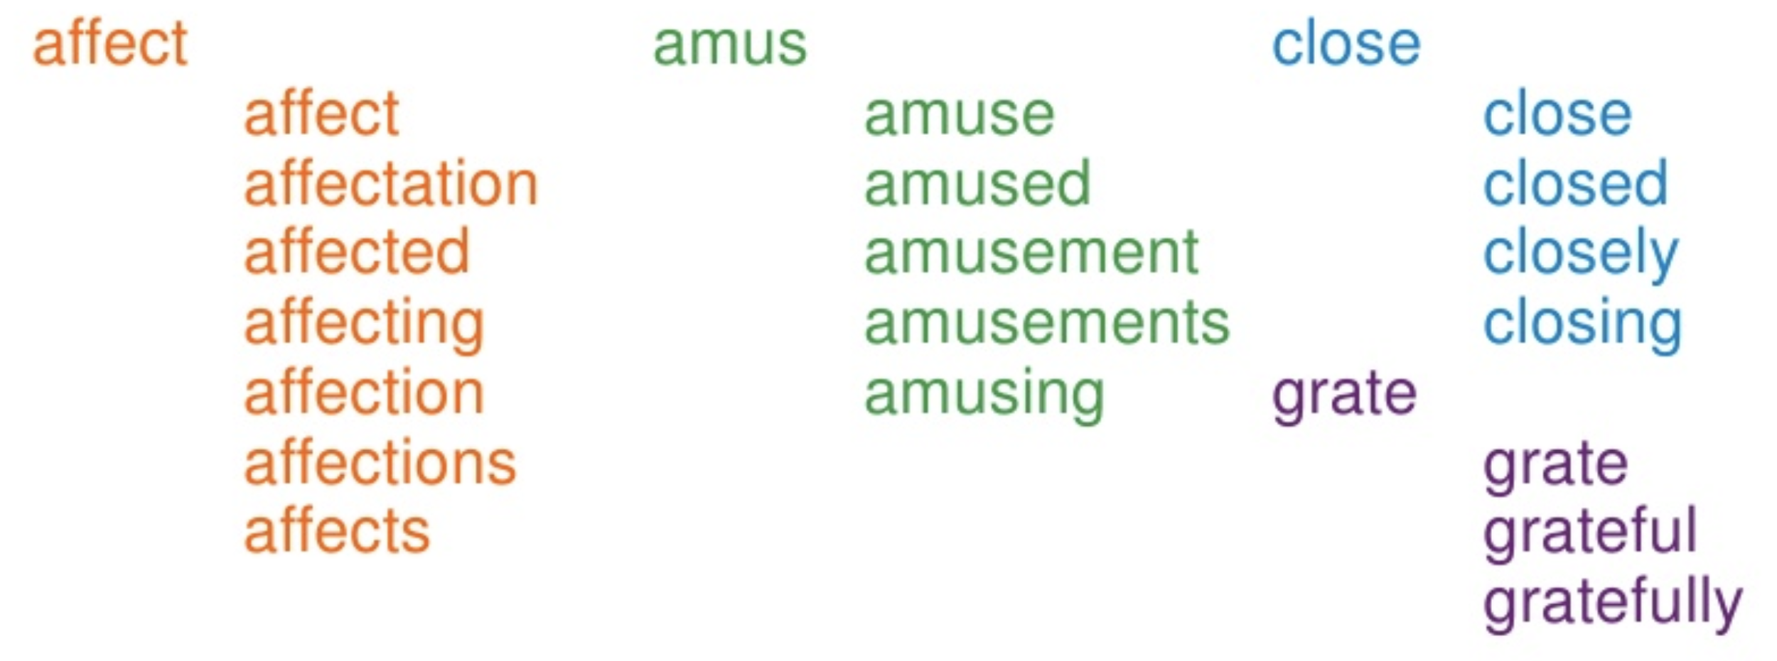
Stemming and Lemmatization
Stemming is typically faster, more naive word shortening. (crude affix chopping) It is language dependent.
Lemmatization take deeper approach to extracting lemmas of the words (part of speech, language specific dictionary, etc.). Lemmatization implies doing “proper” reduction to dictionary headword form am, are, is → be car, cars, car's, cars' → car
© Lightweight NLP
Notes:
language specific dictionary with mapping between words and lemmas

Slide 27
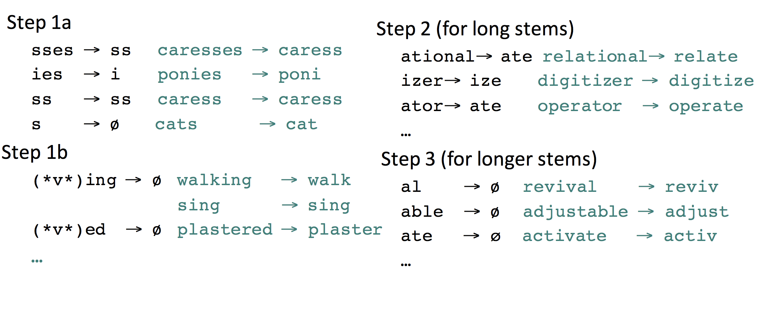
Porter Stemmer
© Taken from the Jurafsky lecture notes: https://web.stanford.edu/~jurafsky/slp3/slides/2_TextProc.pdf

Slide 28
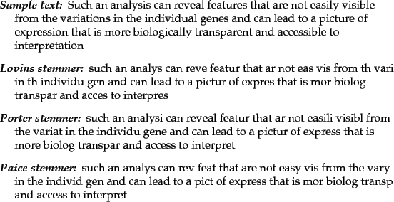
Sample stemmings

Slide 29
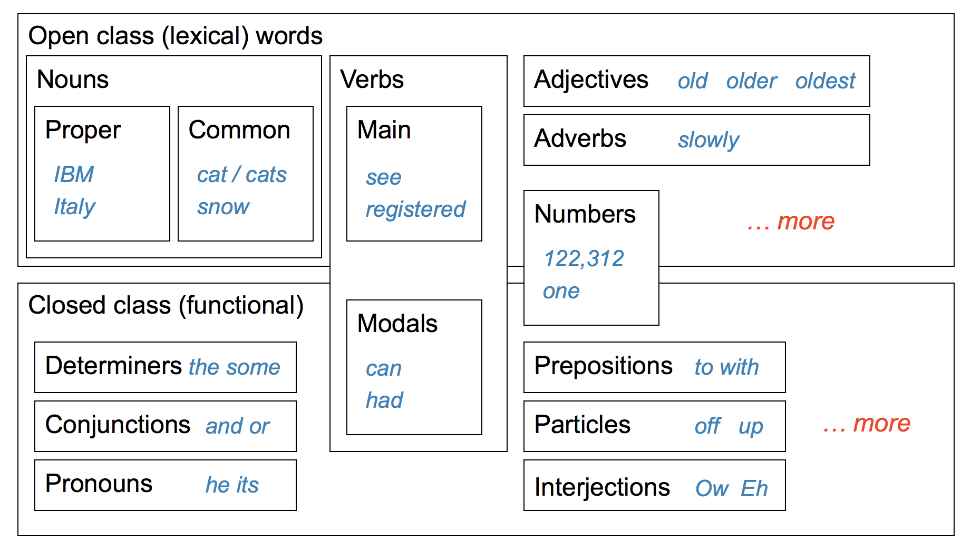
Part-of-Speech Tagging
© Taken from Chris Manning lecture slides. Full copy is here: http://spark-public.s3.amazonaws.com/nlp/slides/Maxent_PosTagging.pdf

Slide 30
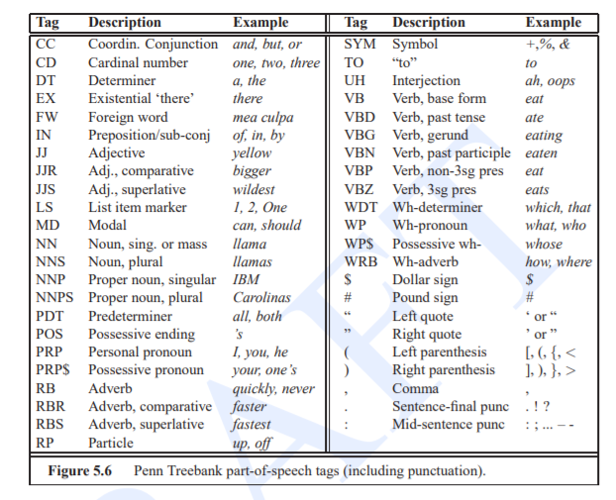
Part-of-Speech

Slide 31
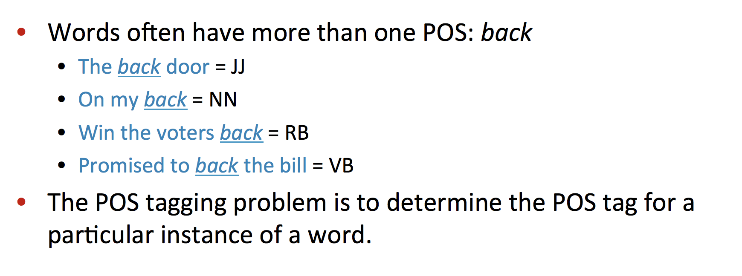
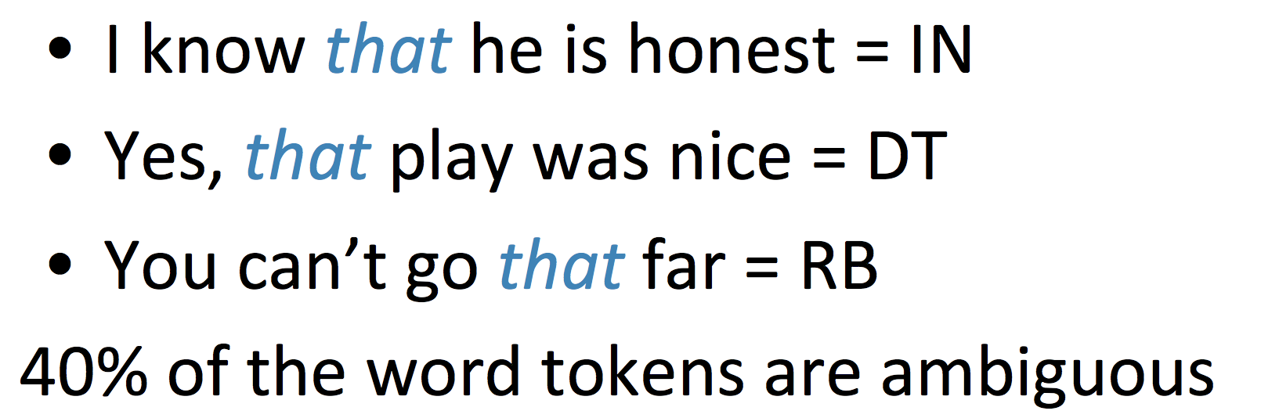
POS Tagging
© Taken from Chris Manning lecture slides. Full copy is here: http://spark-public.s3.amazonaws.com/nlp/slides/Maxent_PosTagging.pdf

Slide 32
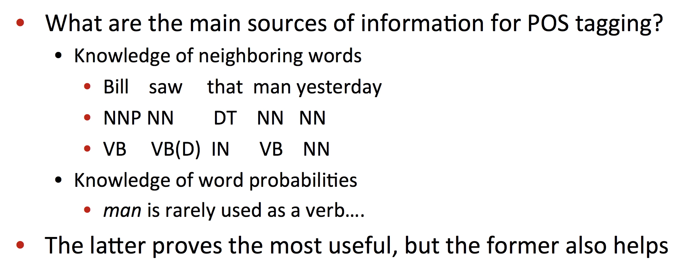
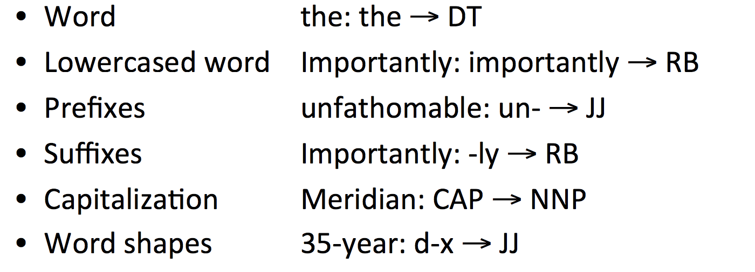
POS Tagging
© Taken from Chris Manning lecture slides. Full copy is here: http://spark-public.s3.amazonaws.com/nlp/slides/Maxent_PosTagging.pdf

Slide 33
Parse Trees
Constituency trees: structure of nested phrases/constituents
Dependency trees: actual dependencies between words
S
saw
nsubj
dobj
NP
VP
John
Mary
John
V
NP
saw
Mary
Notes:
Constituency-based parse trees
Is a parse tree where the phrase structure grammars are preserved.
This tree is a binary tree that contains non-terminal nodes (phrases) and terminal nodes (actual words).
The standard structure of a sentence is S=NP VP, that is a sentence should contain a noun phrase and a verbal phrase.
Dependency-based parse trees
In these trees, all nodes are terminal where edges specify the actual dependencies between the words.
This means that there are less nodes in such trees (since we do not create non terminal nodes).
The constituency is also acknowledged in such graphs as any complete sub-tree. The tree could employ various dependencies: morphological, semantic, syntactic.
Syntactic functions of such tree could be useful if you are interested in extracting some particular phrases, or construction: e.g., you can get information if something is an ATTRibute of an object, or if a noun is a COMPlement TO the object, you can also discover what is a subject and what is an object in the sentence, etc.
Material based on Wikipedia: https://en.wikipedia.org/wiki/Dependency_grammar
Chris Manning lecture slides. Full copy is here: http://spark-public.s3.amazonaws.com/nlp/slides/Parsing-Dependency.pdf
Example idea from https://www.nltk.org/book/ch08.html

Slide 34
Parse Trees: Why to use?
To find the root / main intent of the query / sentence.
To find the modifiers / arguments of known frames (e.g. set alarm __WHEN__).
Build event-like feature representations: nsubj('<someone>', 'saw').
Extract smarter n-grams based on parse trees.

Slide 35
Constituency Parse Trees: Build with Probabilistic Context-Free Grammars
S
NP
VP
1.0
N
cat
0.4
S
NP
NP
NP
0.1
N
fish
0.4
NP
NP
PP
0.3
N
saw
0.2
NP
VP
NP
N
0.6
V
meets
0.4
PP
P
NP
1.0
V
saw
0.2
V
greets
0.4
cat
V
NP
VP
V
NP
0.7
VP
VP
PP
0.3
saw
fish
Notes:
Full slides: http://spark-public.s3.amazonaws.com/nlp/slides/Parsing-Probabilistic.pdf
P(t) – The probability of a tree t is the product of the probabilities of the rules used to generate it.
P(s) – The probability of the string s is the sum of the probabilities of the trees which have that string as their yield

Slide 36
Text representation

Slide 37
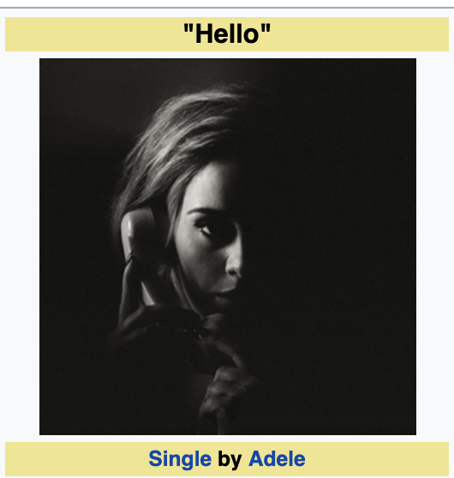
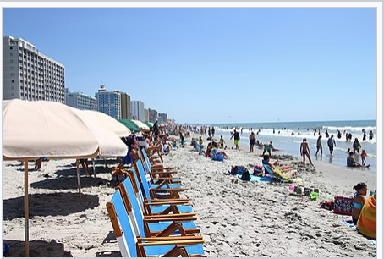
Text representations
Idea: Represent the text so that the machine can perform its processing. The text representations are usually inputs for machine-learning models.
Different approaches*:
Lexical
Linguistic
Entities
Embeddings
NOUN
Hello
Summer
Summer
Summer
Summer
INTERJECTION
Participants
Hello
Participants
Hello
NOUN PL
School
Participants
Participants
School
Greetings
NOUN
Hello
School
School
Person
Event
* (that we will discuss)
Notes:
Lexical: bag-of-words / n-grams
Linguistic (syntactic or semantic): Part-of-speech tags, syntax trees, semantic role labels
Entities (sparse semantic representation)
Word embeddings (dense semantic representation)

Slide 38
Bag-of-words (BOW) representation
Idea: Split the text into tokens (~words), extract their counts, and build their vector.
Input text: "Hello, Summer school participants!"
Set of normalized words: hello, summer, school, participants
As a count vector: [0 0 0 1 0 0 0 … 0 1 0 0 … 0 0 1 0 … 0 0 0 1 0 …0 ]
(hello)
(summer)
(participants)
(school)
Notes:
Split the text into tokens (~words), count which tokens are present, build a vector for each input text.
The ML / NLP model then can learn the to reason about particular annotations / predictions based on which words (or word combinations) are present (or absent) in texts.
E.g. if we want to classify whether the speaker is happy, the presence of the word 'happy' might be indicative of it. Unless… negation or part of the collocation (happy hour).
Note: It's not possible to enumerate all possible words.

Slide 39
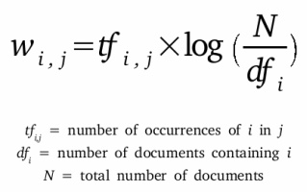
TF-IDF, Conditional Probability, etc.
Weighting tokens/features:
P (word_i | document_j) / P (word_i | all_documents)
Removing noise:
Remove tokens that are very frequent
Remove tokens that have very low TF-IDF
Compare frequency distributions of 2 independent datasets and diminish the intersection.
Notes:
We care how probability of a word changes in a given document with respect to the overall probability.

Slide 40
Bag-of-words: Pros & Cons
Pros:
Very simple, no need for special annotations
Cons:
Can have too many low-occurring words
Breaking collocations, e.g. "happy hour", "new york"
Breaking syntax structure, e.g. "John saw Mary" or "Mary saw John"
Purely lexical, no notion of semantics:
Different representations for similar concepts, e.g. synonyms ("phone" vs. "telephone")
Same representation of ambiguous words, e.g. "buy jaguar car" vs. "jaguar in nature"

Slide 41
N-grams representation
Idea: Take all longer consecutive token sequences as a vector.
Input text: "Hello, Summer school participants!"
Normalized text: "hello gwe school participants"
Extracted n-grams:
unigrams: hello, summer, school, participants
bigrams: hello summer, summer school, school participants
trigrams: hello summer school, summer school participants
4-grams: hello summer school participants

Slide 42
N-grams: Pros & Cons
Pros:
Can capture some structure and connotations
Quite powerful
Cons:
Aggravated data sparsity
Longer n-grams appear even less frequently than particular unigrams
Correlated features
BUT: still works in practice
Plus other problems for lexical-level representation

Slide 43
Linguistic representation:
POS (Part-of-Speech)Tags
Idea: Capture better word meanings by assigning a POS tag to each word.
Why? Some words can have several POS tags: back (JJ/adjective) vs. back (NN/noun)
Input text: "Hello, Summer school participants!"
Annotated text: Hello/UH Summer/NNP schjool/NN participants/NNS
(interjection)
(proper noun)
(singular noun)
(plural noun)
Notes:
Then, instead of the words, one can use words + POS tags. The simple counts of POS tags is also powerful for some tasks (e.g. authorship attribution, psychological profiling).
Knowing POS tags makes it possible to link the words to dictionary entries (more meaning + normalization).
Knowing POS tags is also a basis for using a language grammar and reconstruct its syntax structure.

Slide 44
Linguistic representation: Syntax parse trees
Idea: Capture the syntactic structure of the sentence in a tree format.
Dependency trees: actual dependencies between words
Why?
Can identify sentence root
Can extract smarter lexical features:
hello participants from "Hello Summer school participants"
saw
nsubj
dobj
John
Mary
Notes:
There are also constituency trees, but the structure is quite similar.

Slide 45
Linguistic representation: Semantic role labels
Why? Get more semantic text understanding in order for machine to act on it.
Input query: "play Rolling Stones on youtube"
Role labels annotations: "play/ACTION rolling stones/ARTIST on youtube/APP"
Current state: Application-specific, usually focusing on particular label sets.
Notes:
Concept of semantic frames: which concept takes which arguments.

Slide 46
Linguistic representations: Pros & Cons
Pros:
Can link to more formal language representation (e.g. language grammar)
Captures more meaning (better disambiguation & connotation structure)
Cons:
Each layer of annotations adds errors and computational complexity

Slide 47
Entity representation
Idea: Link the lexical forms of entities mentioned in the text to their actual identities (entities defined by non-ambiguous ids).
Examples:
Final text representation: a vector of detected entities.
"buy jaguar"
/wordnet/jaguar_car_brand
"jaguar in the nature"
/wordnet/jaguar_animal

Slide 48
Entity representation: Pros & Cons
Pros:
Can disambiguate lexical forms into entities, e.g. "jaguar" in context
Can match different lexical forms into the same entity, e.g. "phone" and "telephone"
Has information about entity relations, e.g. "/knowledgebase/iphone" is produced by "/knowledgebase/apple"
Cons:
Introduces the room for interpretation mistakes
Only entities! Does not represent (yet) intents, common adjectives, nouns, etc.
Hello
Summer
School
Participants

Slide 49
Word embeddings: Dense semantic representation
Idea: Each word corresponds to a vector in multi-dimensional space.
Desired property:
Similar words are close to each other in that space, while unrelated words are further apart.
hello
Summer
school
participants
(context)
(context)
(center word)
(context)
Sentence representation: Represent an input text as one multi-dimensional vector.
Average embedding of all input words
Train models to represent sequences (Deep Learning)
Word2vec visualization

Slide 50
Embeddings representation: Pros & Cons
Pros:
Allow direct vector operations (dense representation)
Can capture text semantics
Really powerful at data generalizations
Cons:
Less interpretable
Require tons of data for training
BUT: Pre-trained models are available!
Computationally expensive
BUT: Often can be precomputed.

Slide 51
Text representations: Summary
Lexical
Linguistic
Entities
Embeddings
NOUN
Hello
Summer
Summer
Summer
Summer
INTERJECTION
Participants
Hello
Participants
Hello
NOUN PL
School
Participants
Participants
School
Greetings
NOUN
Hello
School
School
Person
Event
These representations are only the input for the models. The models can build even better representations of the full text by further processing them.
google/sentencepiece
Notes:
Different representations:
Lexical: bag-of-words / n-grams
Linguistic (syntactic or semantic): Part-of-speech tags, syntax trees, semantic role labels
Entities (sparse semantic representation)
Word embeddings (dense semantic representation)
Mention: Does not preserve word order:
Depending what is your particular problem, you might need to care about the order of words in your input data.
This could happen either on the data preprocessing step, where you would encode the order as part of the feature input, e.g., n-grams, specific features that correspond to the positions of the words. Further all those features are sent to the particular methods of your choice.
If you do not want and can't pollute the input with those additional information, you might need to reply on the methods that implicitly encode the order in the data as they read the input.
Hidden Markov Models (HMM on wiki, HMM Fundamentals), Conditional Random Fields (CRF), Recurrent neural networks, etc.

Slide 52
Real text problems: Document classification

Slide 53
Document Classification
Text document
YES
RELEVANT
NO
NOT_RELEVANT
Given a set of labels/classes, need to assign labels to each document.
Examples:
Spam filtering,
sentiment analysis,
documents retrieval (finding relevant documents),
new topic classification

Slide 54
Rule-based classification
Text document
YES
RELEVANT
Are there any relevant terms present?
NO
NOT_RELEVANT
How to find which terms/words are relevant and which are not?
Building lexicons

Slide 55
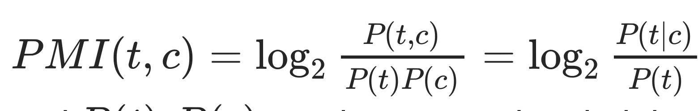
Pointwise Mutual Information (PMI)
term
class
Notes:
Originally, PMI of two words: Do words x and y co-occur more than if they were independent?
One classic way to document classification is to classify texts based on the presence of terms from either existing or heuristically built lexicons.
Pointwise Mutual Information (or PMI) can be a great estimator of the informativeness or relevance weight of words. It was originally introduced to measure how strongly two words are associated, that is how often they go together among their occurrences.
In the context of classification, PMI measures the relatedness between a term 𝑡 and a certain class 𝑐 . It is defined as follows:
𝑃𝑀𝐼(𝑡,𝑐)=log2𝑃(𝑡,𝑐)𝑃(𝑡)𝑃(𝑐)=log2𝑃(𝑡|𝑐)𝑃(𝑡) , where 𝑃(𝑡,𝑐) is a joint probability of 𝑡 and 𝑐 , and 𝑃(𝑡) , 𝑃(𝑐) are the marginal probabilities of 𝑡 and 𝑐 .
Another potential reason to explore the most important or relevant keywords in the dataset is to determine whether there are some dependencies and correlations in the data. Thus, confirming potential benefit of the machine intelligence :)
Note: simple correlation measure could be also checked prior to PMI.
-> Go to the colab.

Slide 56
Document Classification

Slide 57
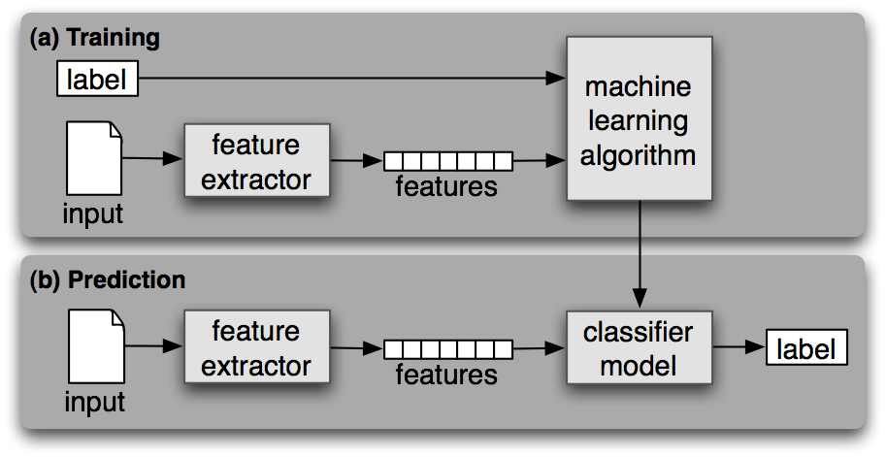
Supervised document classification
© Picture from NLTK: https://www.nltk.org/book/ch06.html

Slide 58
Supervised document classification: Common models
Generative models
Try to generate the observed data from the hidden structure (labels 𝑦)
Model joint probability of 𝑝(X, 𝑦) and try to maximize joint likelihood
Example: Naive Bayes
Discriminative models
Directly estimate a decision rule/boundary
Model conditional probability 𝑝(𝑦 | X) and try to maximize conditional likelihood (give the data X)
Example: Logistic Regression

Slide 59
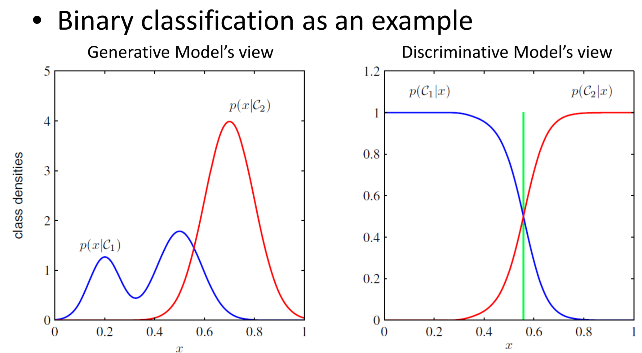
Generative vs. Discriminative
© Whole set of slides here: http://www.cs.virginia.edu/~hw5x/Course/TextMining-2018Spring/_site/docs/PDFs/TextCategorization.pdf
Notes:
Generative (joint) classifiers place probabilities over both observed data and the hidden structure
(a.k.a., generate the observed data from the hidden structure):
Example models: n-gram language models, Naive Bayes, Hidden Markov Models, Probabilistic context-free grammats, etc.
These models give joint probabilities P(X,y) and try to maximize joint likelihood.
Discriminative (conditional) models take the data as given, and put a probability over hidden structure given the data.
Example models: Logistic regression, conditional loglinear or maximum entropy models, conditional random fields, SVM, perceptron, etc.
These models give conditional probabilities P(y|X) and try to maximize conditional likelihood.
Here, the observed data is taken as is and the output class is modelled only using conditional probability.
More details about these model types here.

Slide 60
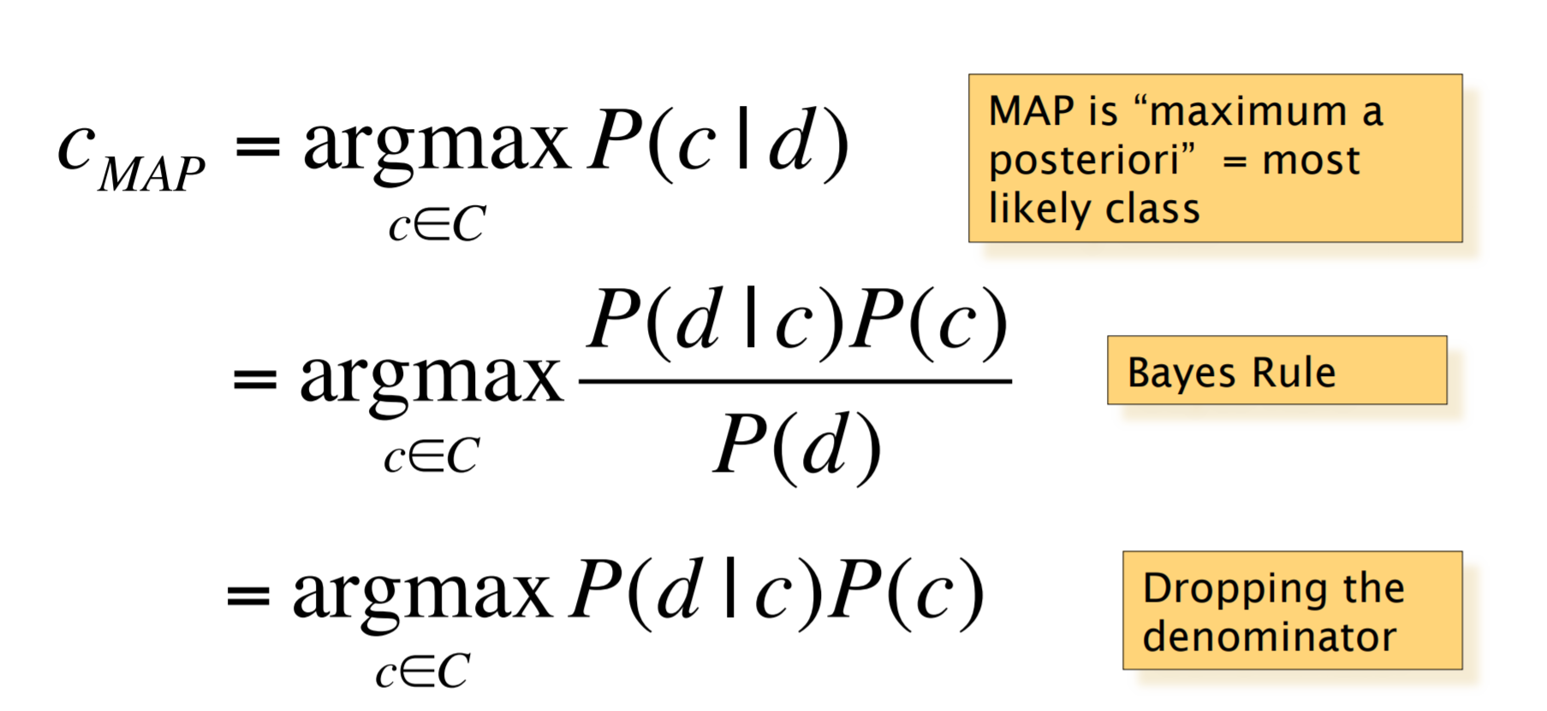
Naive Bayes
© Taken from Chris Manning lecture slides. Full copy is here: http://spark-public.s3.amazonaws.com/nlp/slides/naivebayes.pdf
Notes:
If needed, the full slides on Naive Bayes are here: http://spark-public.s3.amazonaws.com/nlp/slides/naivebayes.pdf

Slide 61
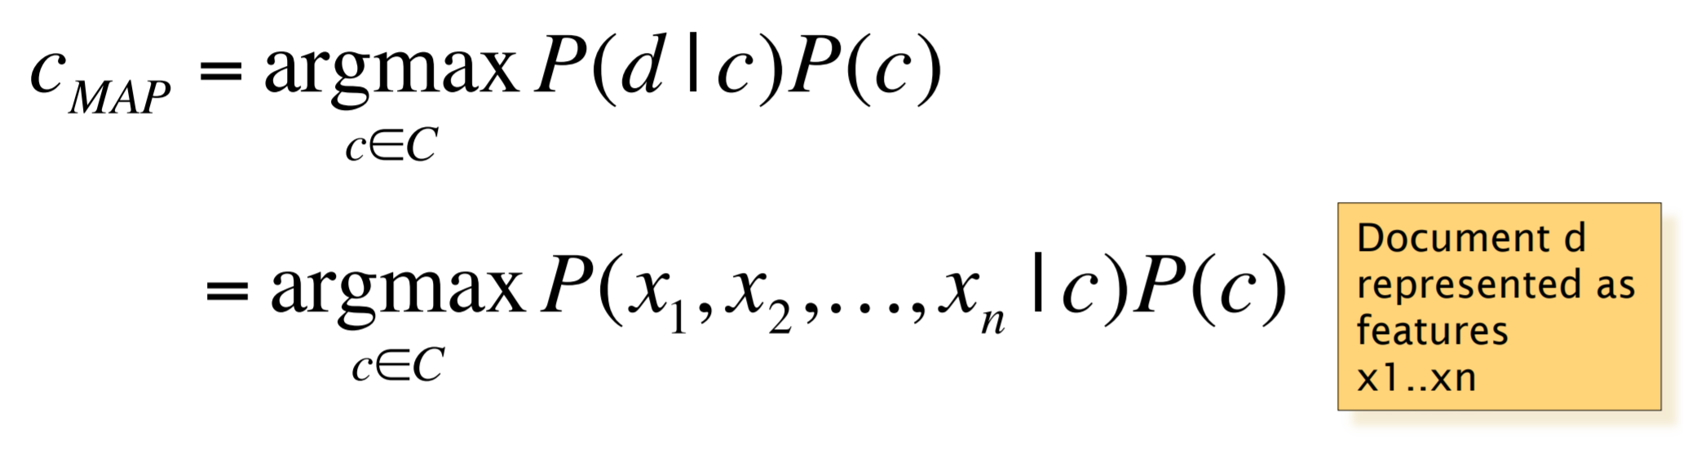
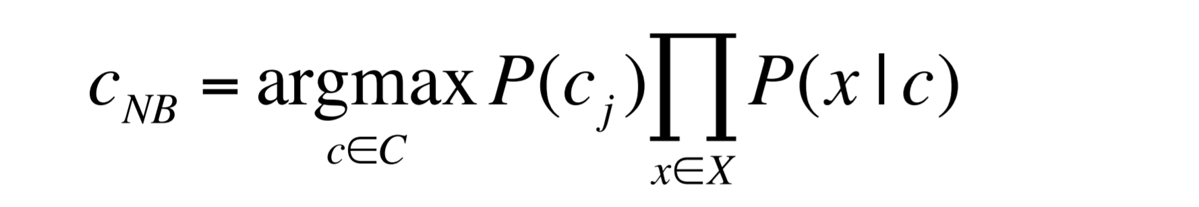
Multinomial Naive Bayes
© Taken from Chris Manning lecture slides. Full copy is here: http://spark-public.s3.amazonaws.com/nlp/slides/naivebayes.pdf
Notes:
Assumptions:
Word position doesn't matter,
words are generated independently.
To train the generative model, we need to estimate probabilities 𝑃(𝑦) and 𝑃(𝑋|𝑦) using given dataset.
Once the training is done, we take new input and we need to make predictions according to:
𝑦̂ =𝑎𝑟𝑔𝑚𝑎𝑥𝑦∈𝑌𝑃̂ (𝑦)𝑃̂ (𝑥|𝑦) using the estimated probabilities.
This step is called inference or decoding.
Two problems remain:
How we should define the distributions 𝑃̂ (𝑦) and 𝑃̂ (𝑋|𝑦) ? (any independence assumptions etc.)
How to estimate the parameters of the distributions from the training data?
Former, is dependent on the application. Quite often, there is a natural decomposition of the input variables 𝑋 in 𝐽 components
(like a document is decomposed to the words/features etc).
The Naive Bayes method makes the following assumptions: 𝑋1,…,𝑋𝐽 are conditionally independent given the class.
As a result, such an assumption, greatly reduces the number of parameters to be estimated (degrees of freedom, dimentionalities) -
from 𝑂(exp(𝐽)) to 𝑂(𝐽) .
Thus, computation become more efficient for large 𝐽 and the risk of overfitting also descreases.
Latter problem, can be solved using maximum likelihood estimation, which aims to maximize the probability of the training sample,
assuming that each point was generated independently from selected distribution. Let's denote such probability as follows:
𝑃(𝑆𝑎𝑚𝑝𝑙𝑒)=∏𝑚=1𝑀𝑃(𝑥𝑚,𝑦𝑚)
=∏𝑚=1𝑀𝑃(𝑦𝑚)∏𝑗=1𝐽𝑃(𝑥𝑚𝑗|𝑦𝑚)

Slide 62
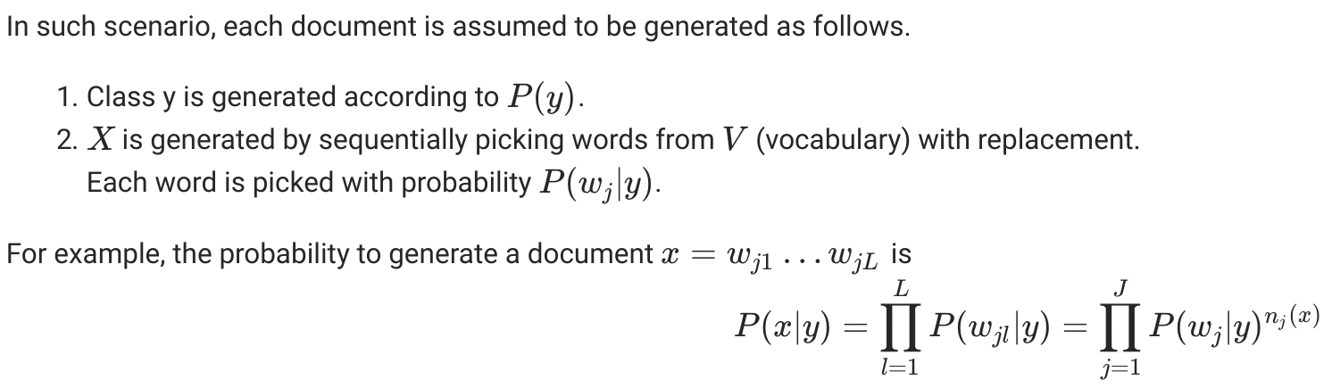
Multinomial Naive Bayes

Slide 63
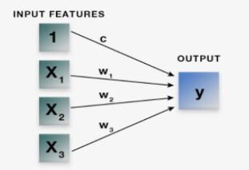
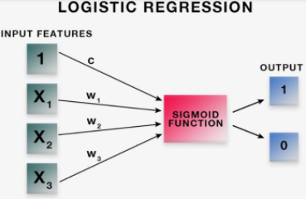
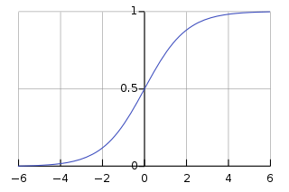
Linear Regression VS Logistic Regression
Image source: https://blog.quantinsti.com/machine-learning-logistic-regression-python/

Slide 64
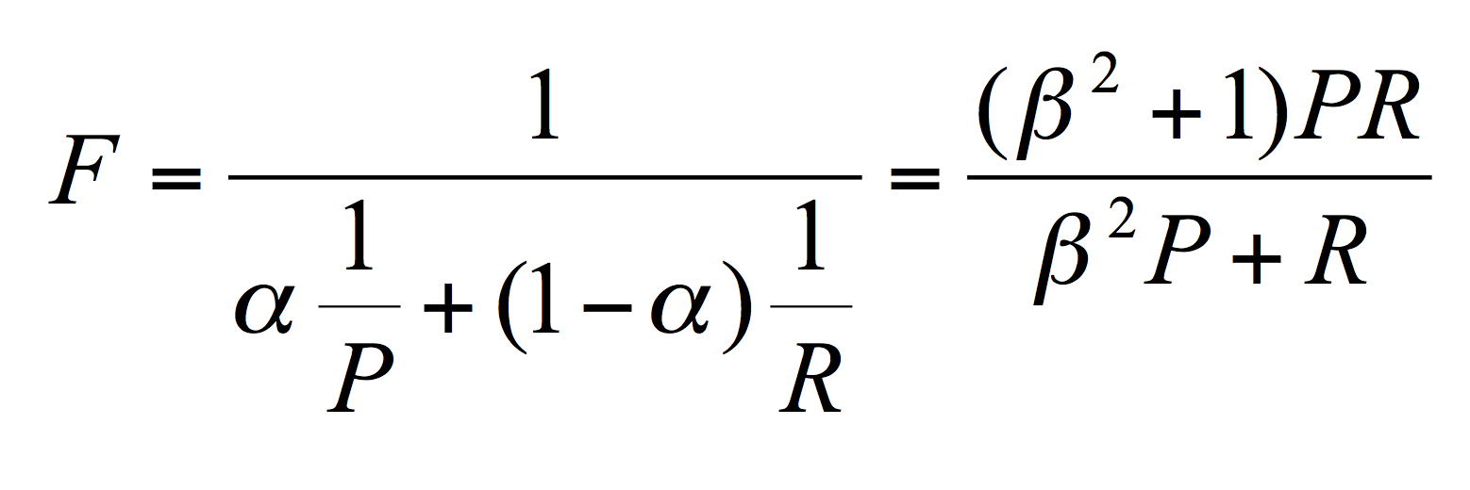
Classification: Evaluation Metrics
Accuracy: % of items classified correctly = (tp + tn) / all
Precision: % of selected items that are correct = tp / (tp+fp)
Recall: % of correct items that are selected = tp / (tp + fn)
 | Actually correct | Actually incorrect
Selected by the algo | True positives | False positives
Not selected by the algo | False negatives | True negatives

Slide 65
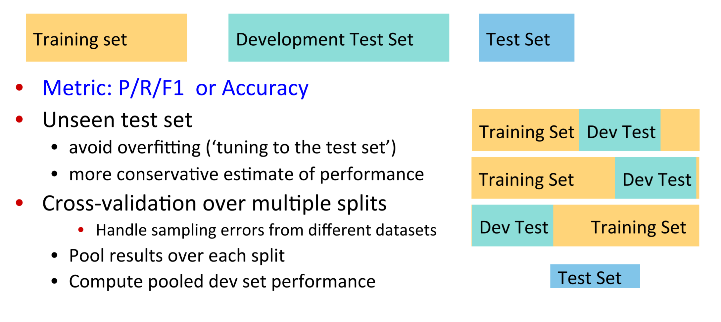
Classification: Common evaluation setup
© Taken from Chris Manning lecture slides. Full copy is here: http://spark-public.s3.amazonaws.com/nlp/slides/naivebayes.pdf
Notes:
Training data vs. test data
Also good to have: intermediate development/validation data
Cross-validation on training or development data

Slide 66
Typical approaches to classification
Type | Input | Idea
Rule-based | Explicit linguistic patterns, lexicons | Apply given rules
Supervised | High-quality annotated data | Learn machine-learning classifier based on annotated examples
Semi- supervised | Annotated & non-annotated data | Use more data to find better feature representation, learn more patterns, or mine new training examples
Distant supervision | Pseudo-annotated data based on some heuristics | Use heuristics to get more training data (often of lower quality or biased)

Slide 67
Text Representation: Word Embeddings
Word embeddings is a set of language modeling and feature learning techniques.
Key idea - dimensionality reduction that captures semantic/morphological/contextual/hierarchical/etc.
preserving the morphological structure (subword information, etc.);
word context representation;
global corpus statistics;
word hierarchy as in WordNet;
relationship between documents and the terms they contain.

Slide 68
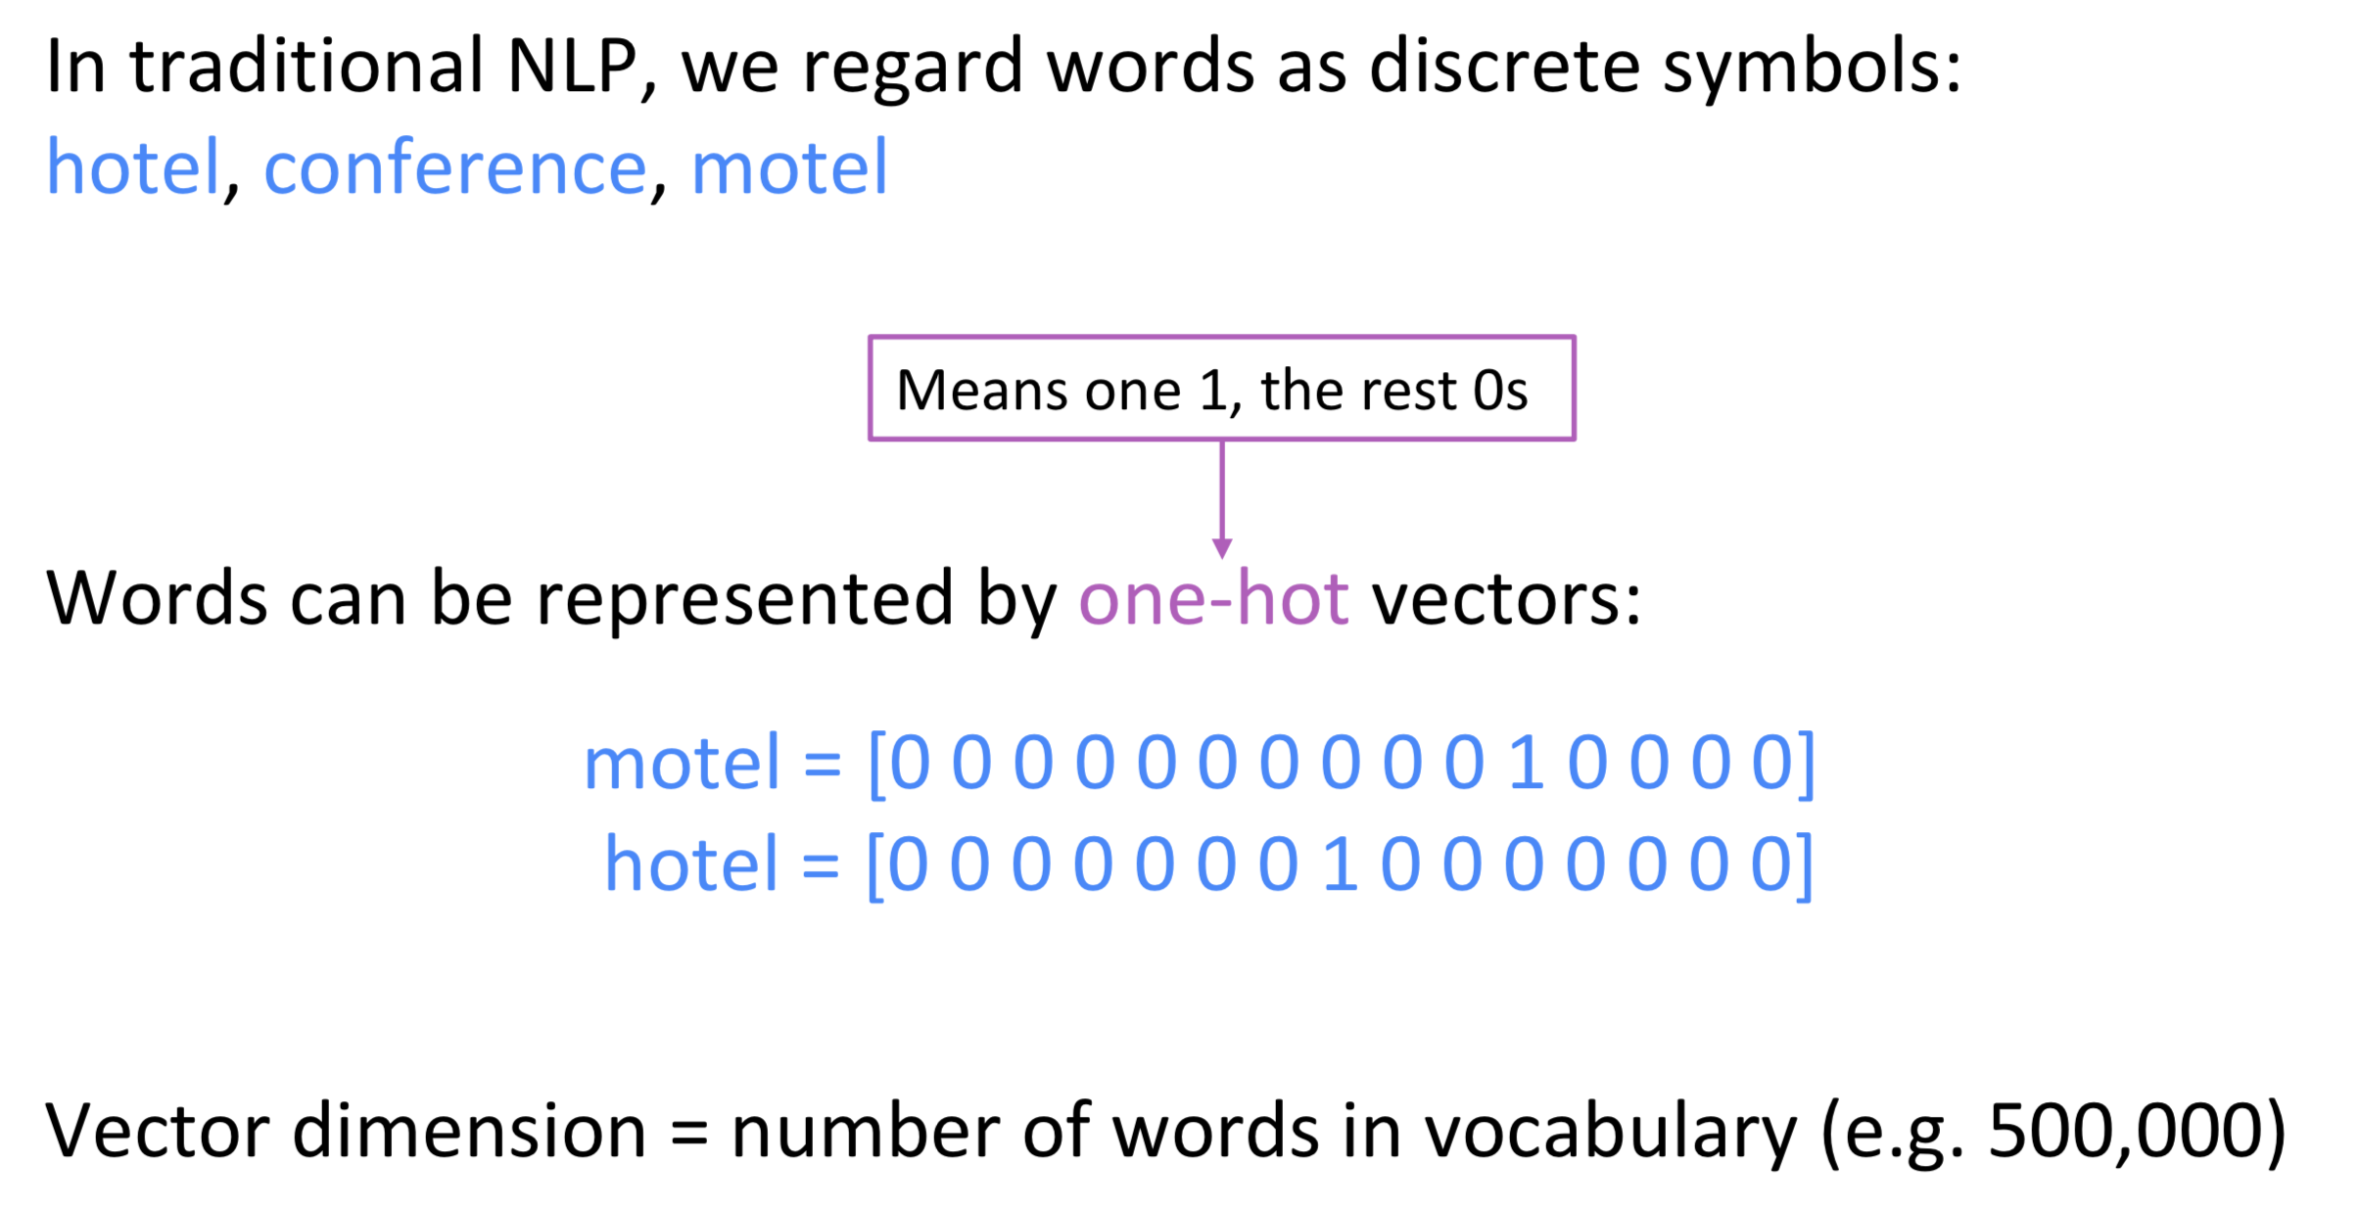
Typical Word Represent with one-hot vectors
© Taken from the Richard Socher class in Stanford
http://cs224d.stanford.edu/lectures/CS224d-Lecture2.pdf

Slide 69
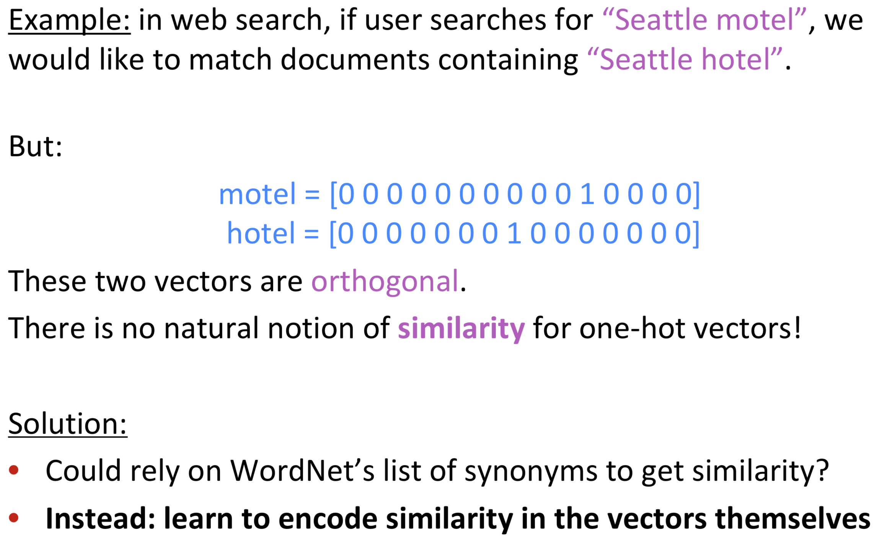
Drawbacks of the one-hot representation
© Taken from the Richard Socher class in Stanford
http://cs224d.stanford.edu/lectures/CS224d-Lecture2.pdf

Slide 70
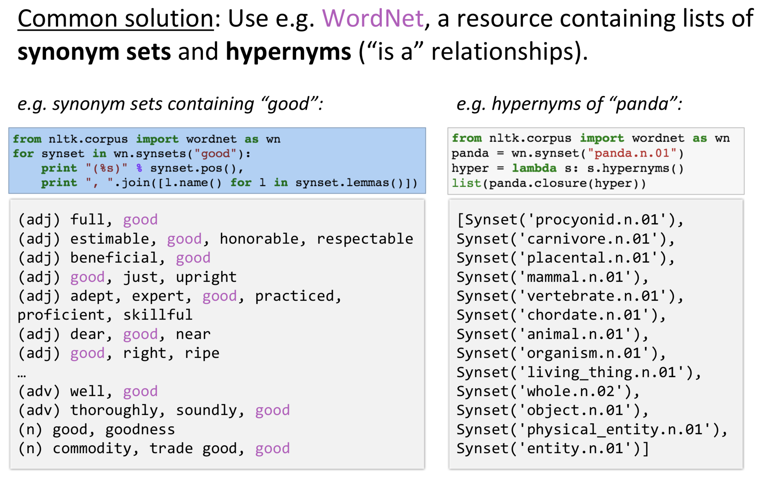
How can we introduce the meaning to the machine?
© Taken from the Richard Socher class in Stanford
http://cs224d.stanford.edu/lectures/CS224d-Lecture2.pdf

Slide 71
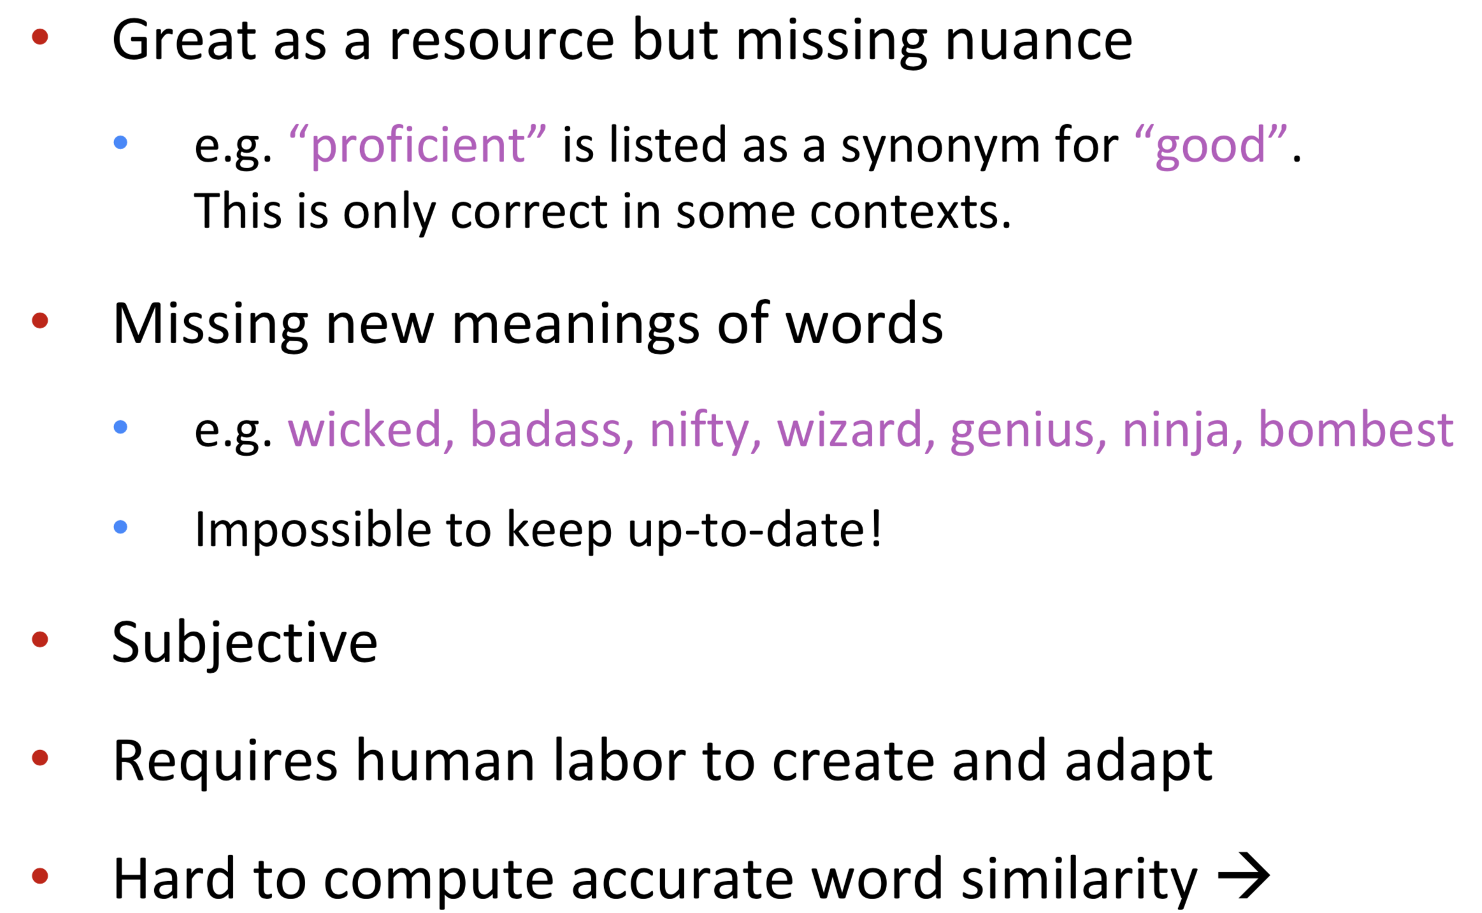
Potential issues with the ontology, knowledge base solutions
© Taken from the Richard Socher class in Stanford
http://cs224d.stanford.edu/lectures/CS224d-Lecture2.pdf

Slide 72
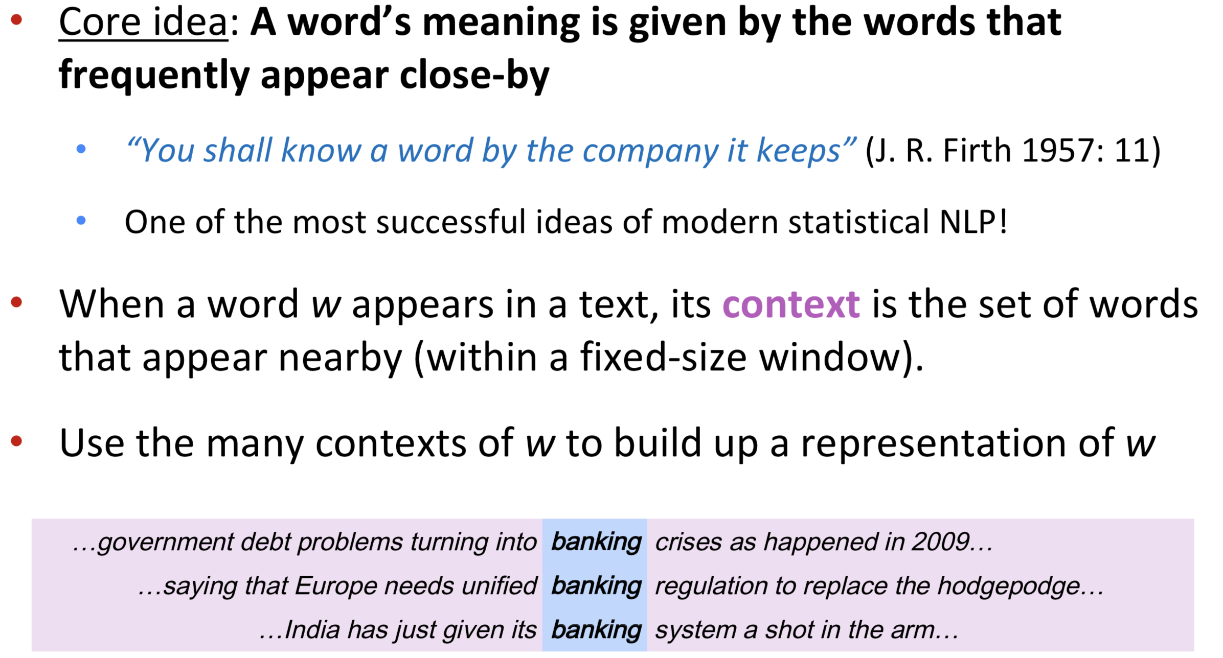
Maybe represent words by their contexts?
© Taken from the Richard Socher class in Stanford
http://cs224d.stanford.edu/lectures/CS224d-Lecture2.pdf

Slide 73
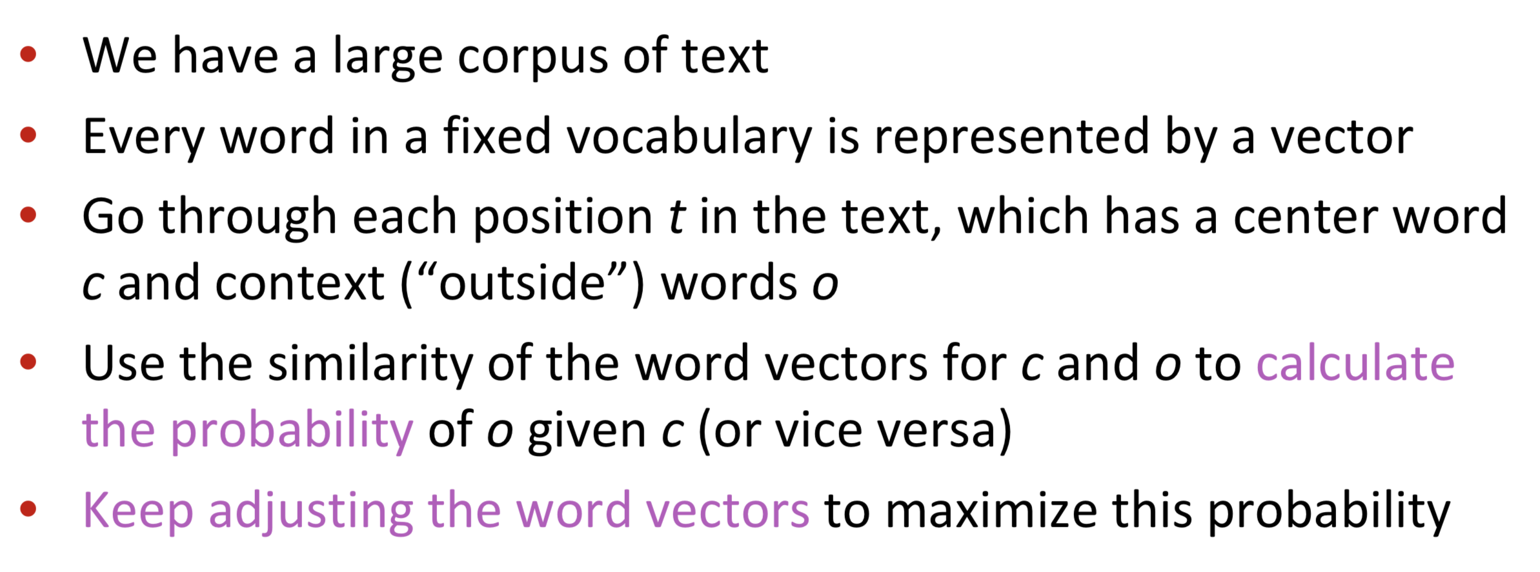
Word2Vec (Mikolov et al. 2015)
© Taken from the Richard Socher class in Stanford
http://cs224d.stanford.edu/lectures/CS224d-Lecture2.pdf

Slide 74
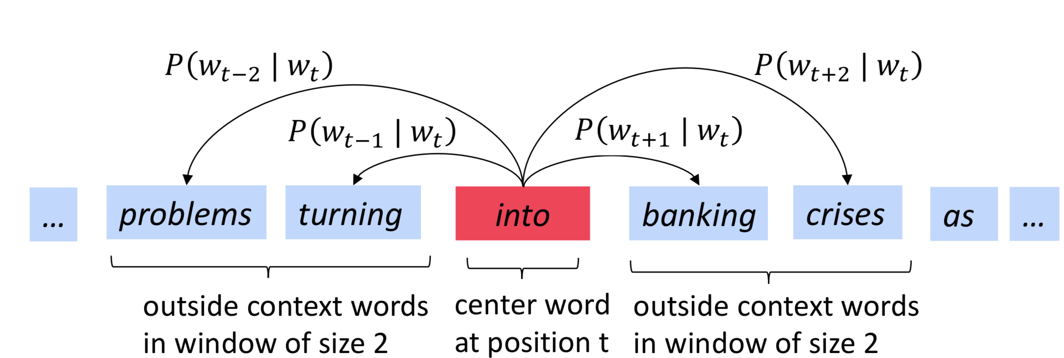
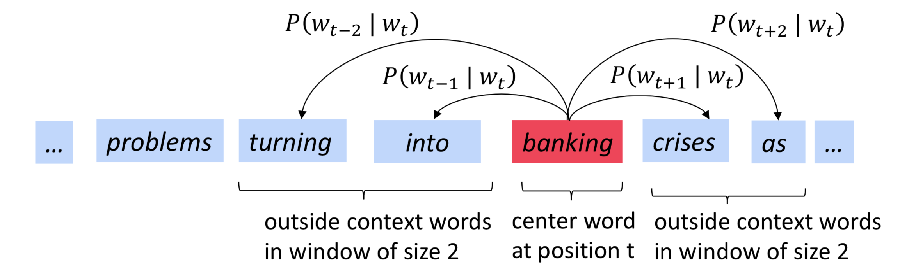
Given a center words compute P(...) of its context
© Taken from the Richard Socher class in Stanford
http://cs224d.stanford.edu/lectures/CS224d-Lecture2.pdf

Slide 75
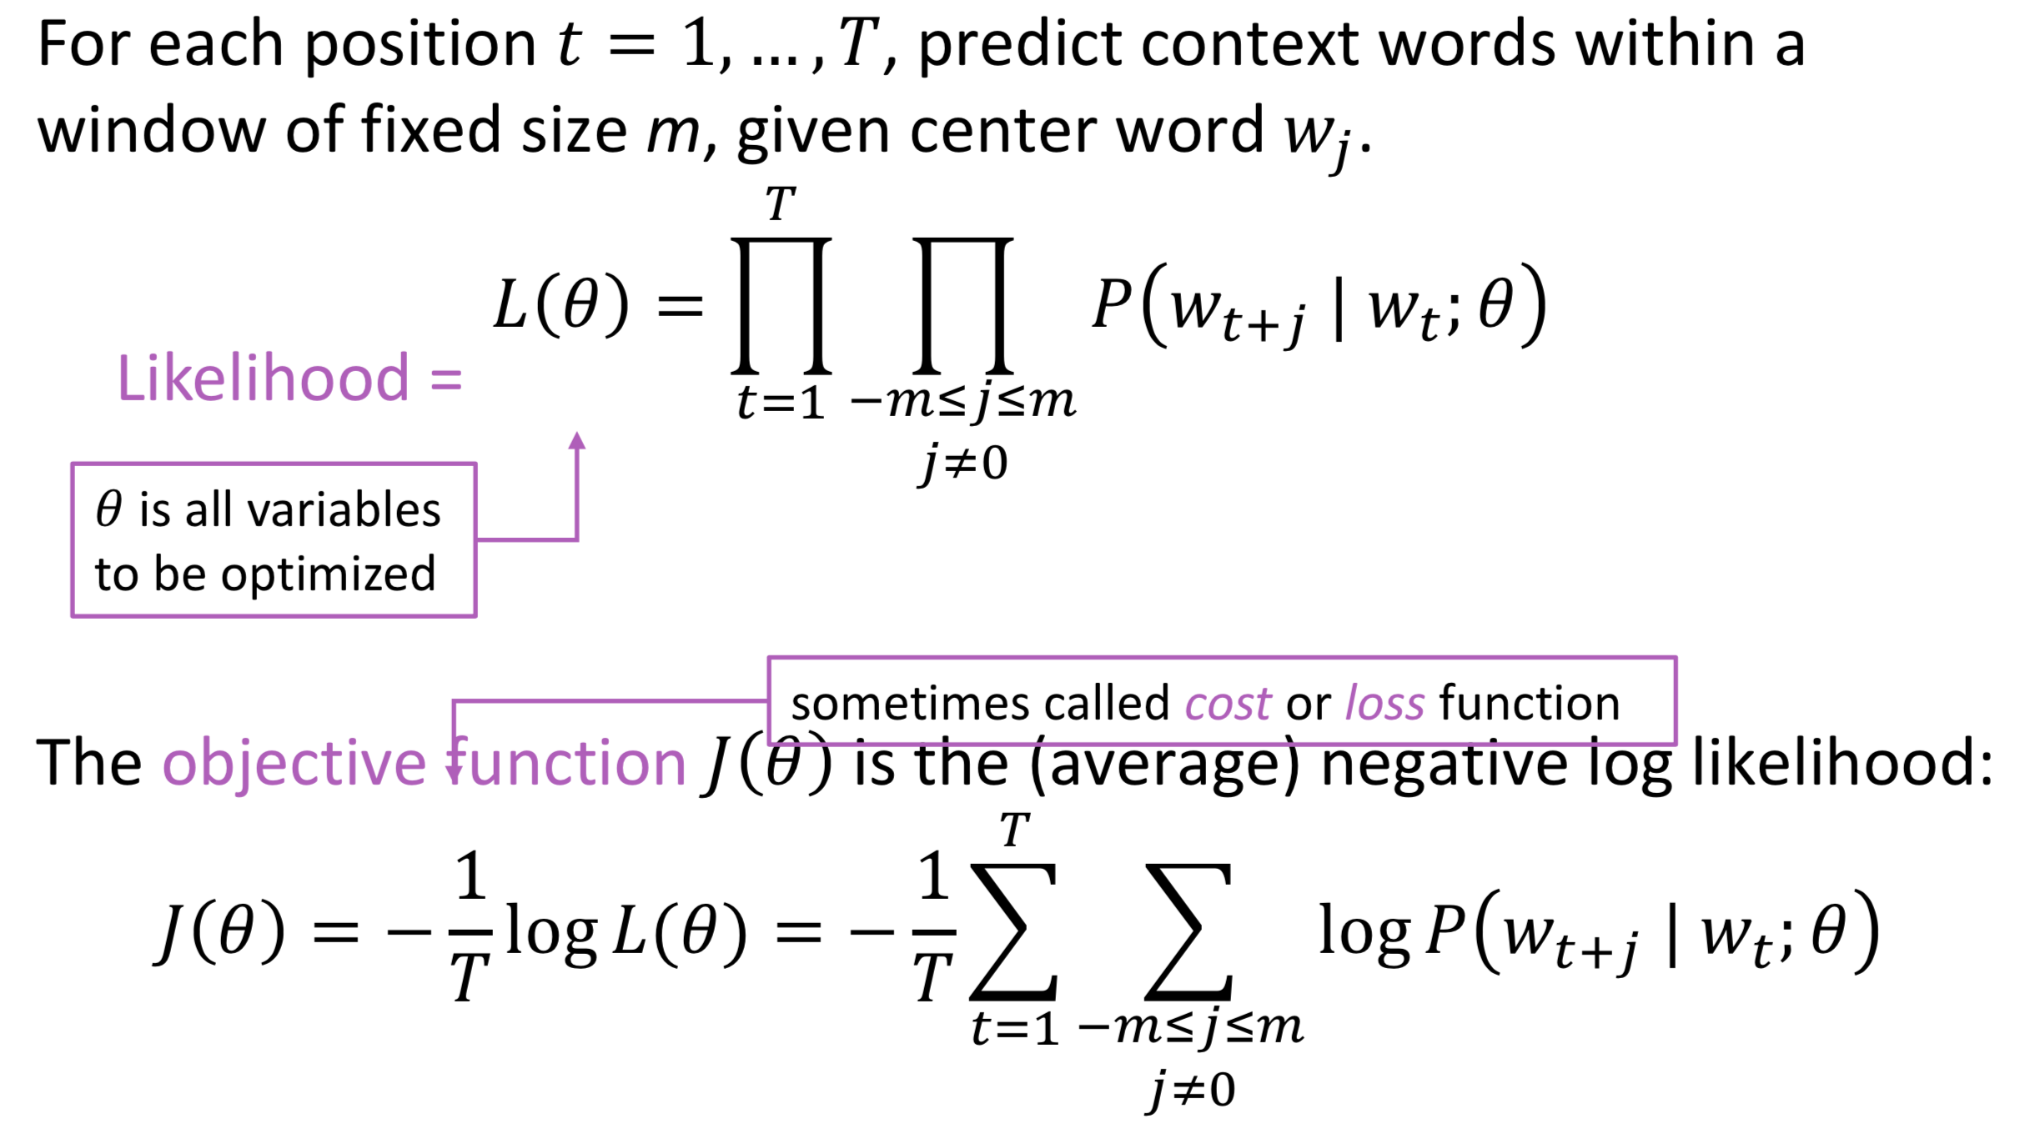
Word2Vec: Objective Function
minimize
© Taken from the Richard Socher class in Stanford
http://cs224d.stanford.edu/lectures/CS224d-Lecture2.pdf

Slide 76
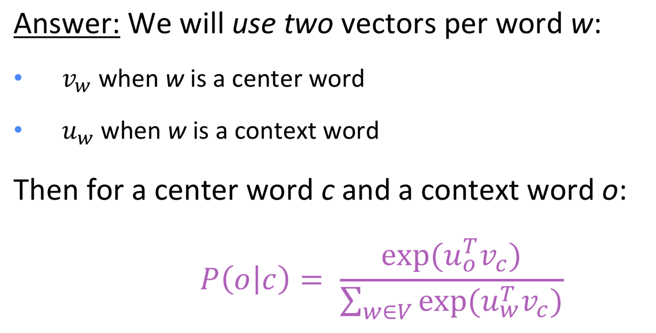
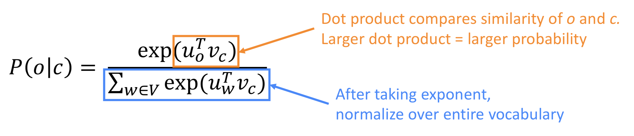
Word2Vec: How to calculate p(neighbors | center)?
© Taken from the Richard Socher class in Stanford
http://cs224d.stanford.edu/lectures/CS224d-Lecture2.pdf

Slide 77
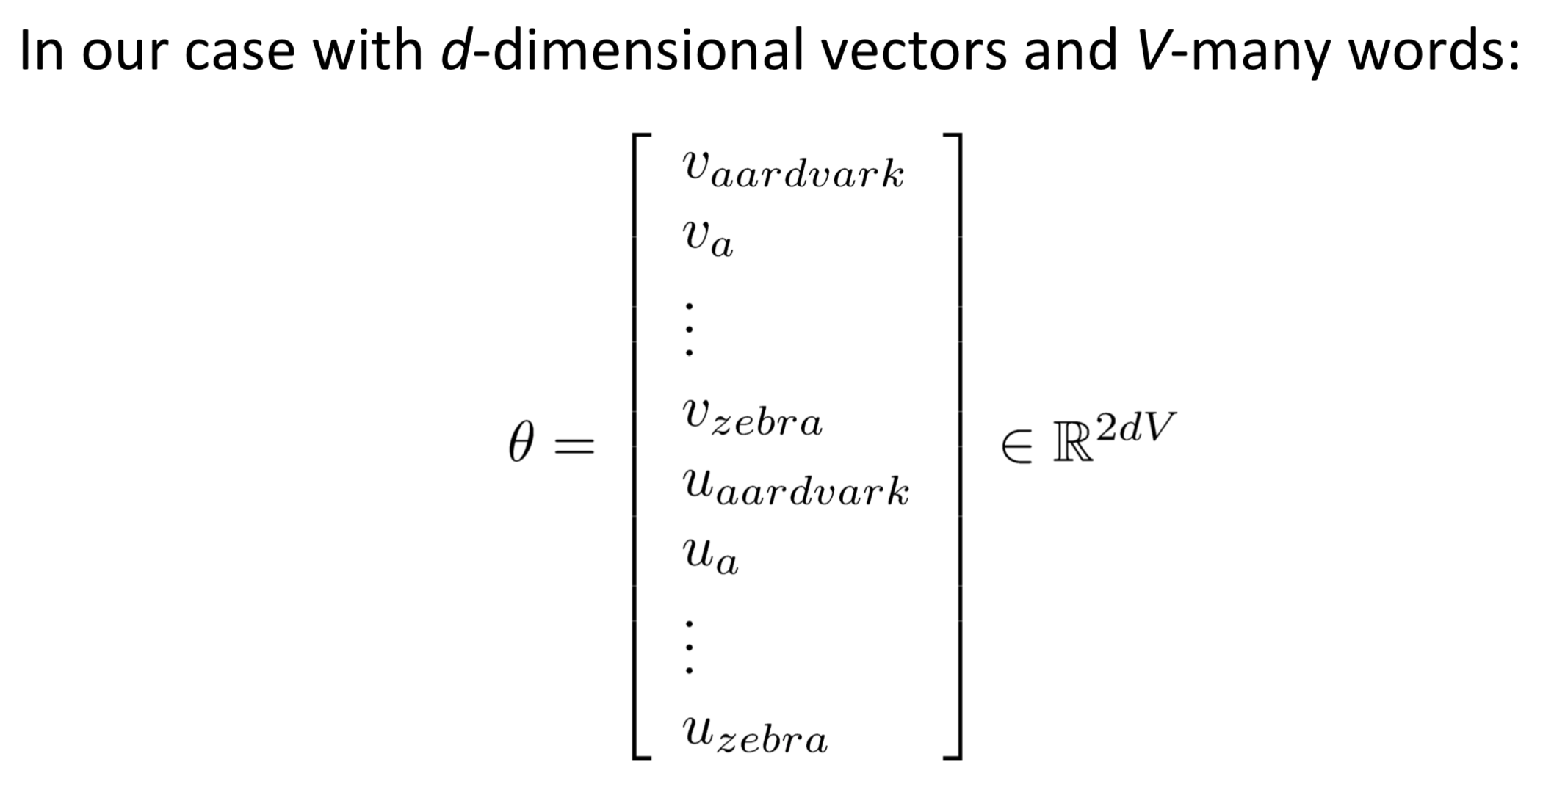
Word2Vec: Parameters of the model
© Taken from the Richard Socher class in Stanford
http://cs224d.stanford.edu/lectures/CS224d-Lecture2.pdf

Slide 78
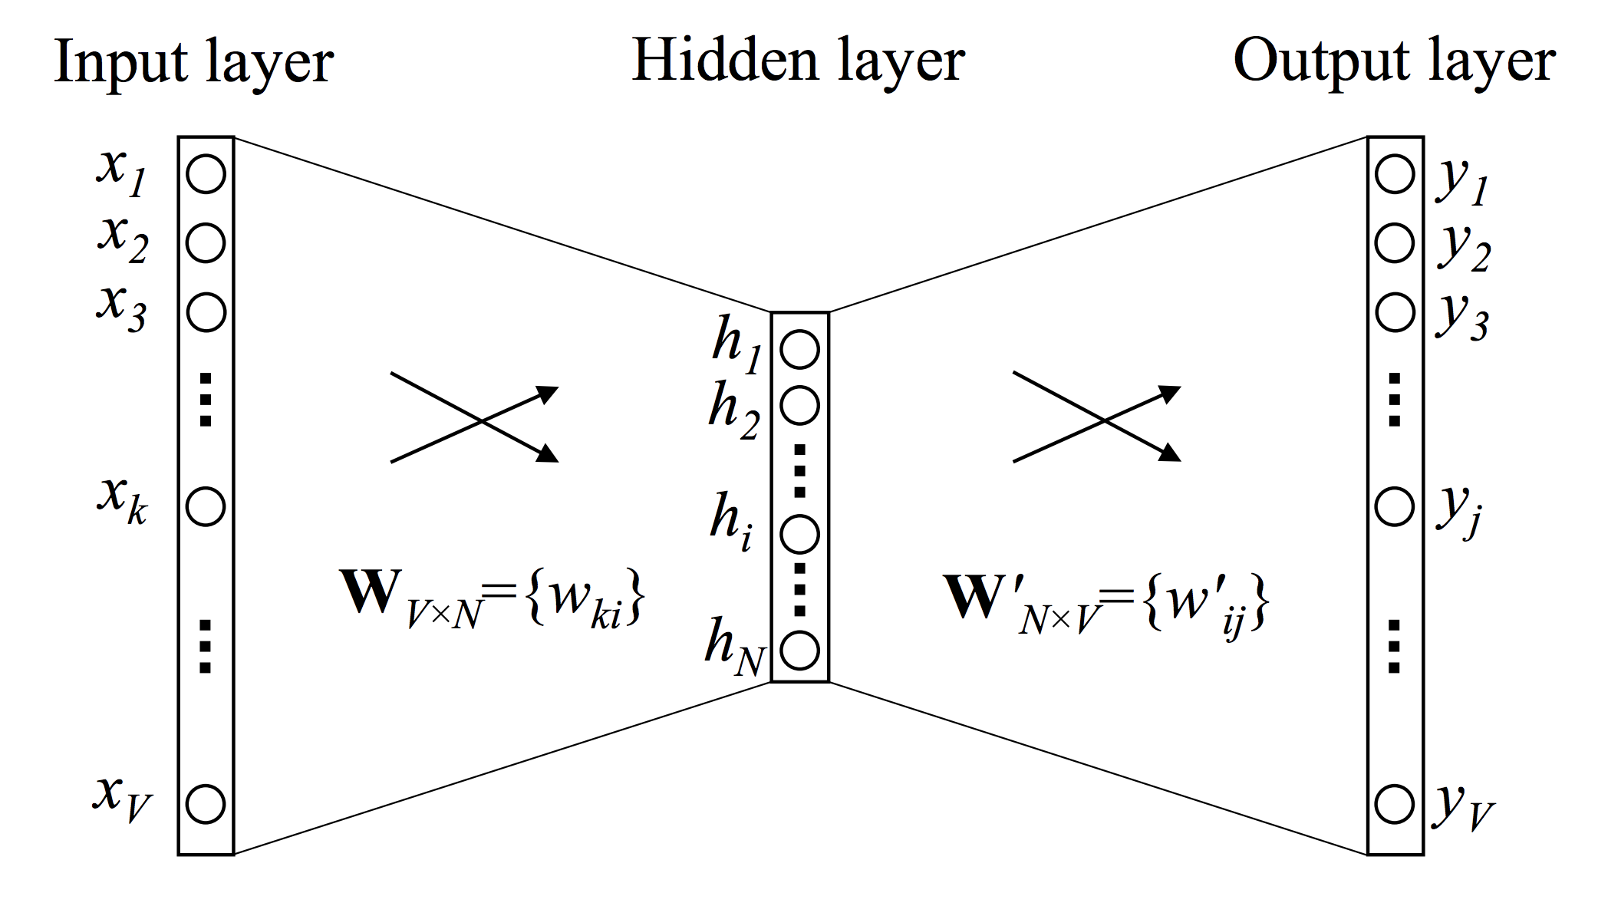
Word2vec One Context Word
© Taken from “word2vec Parameter Learning Explained”
https://arxiv.org/pdf/1411.2738.pdf

Slide 79
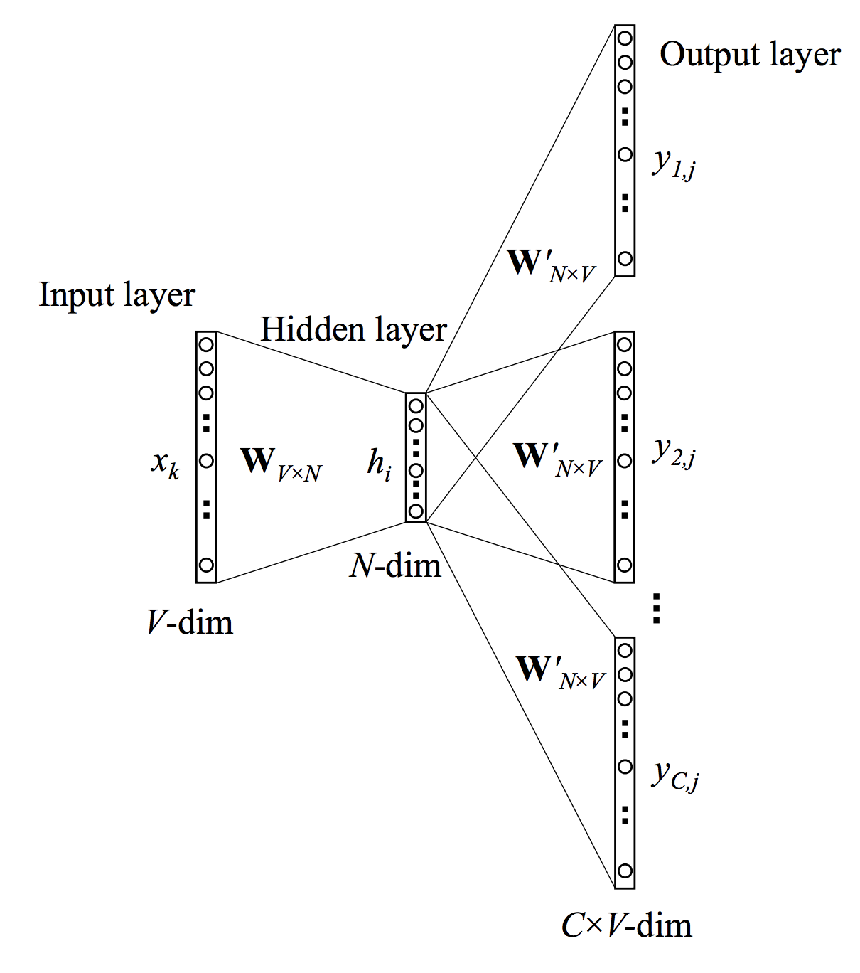
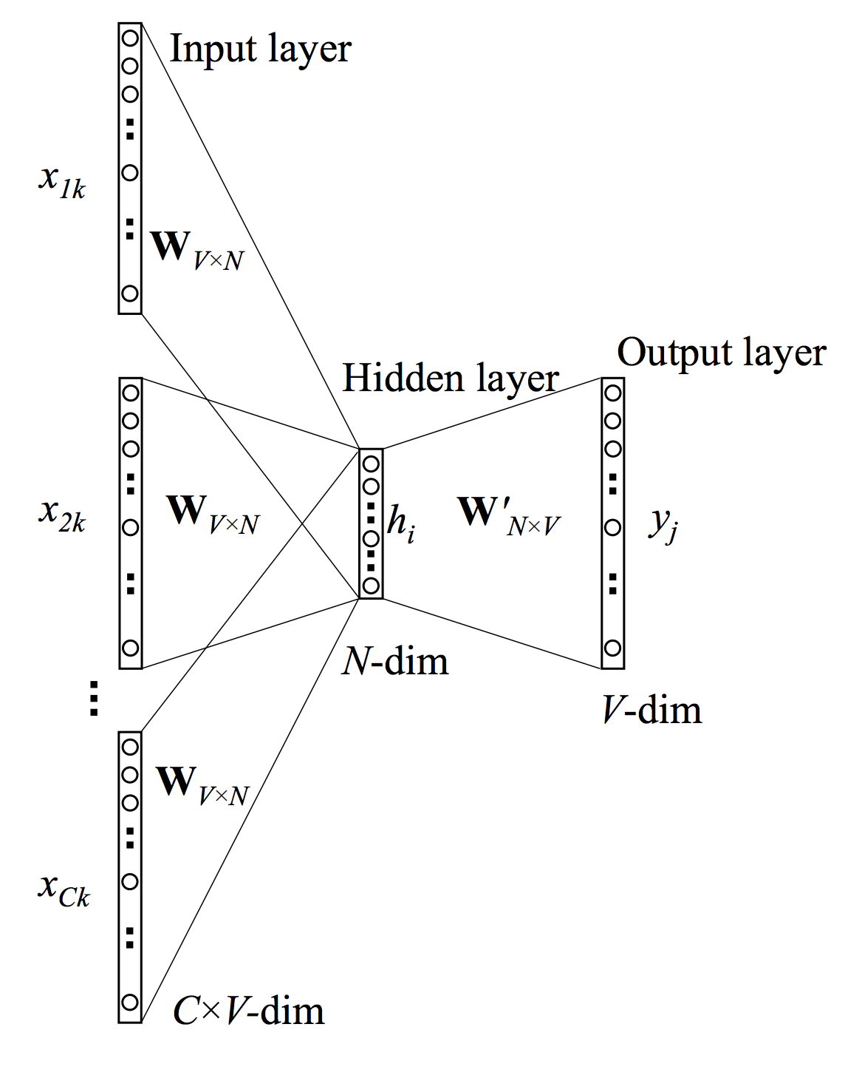
Word Embeddings
skip-gram
CBOW
© Taken from “word2vec Parameter Learning Explained”
https://arxiv.org/pdf/1411.2738.pdf

Slide 80
Word Embeddings Visualization
https://projector.tensorflow.org/
Notes:
Then we go to the colab!

Slide 81
Document Similarity
Topic Modeling

Slide 82
Overview: Similarity, Topicality
Find a document that is more similar to a given input text?
Similarity measures
Text based (edit distance)
Vector space representation based (euclidean distance, cosine similarity, WMD)
Document similarity
Tf-idf representation
W2V representation
Notes:
Explanation in the colab -> Go there.

Slide 83
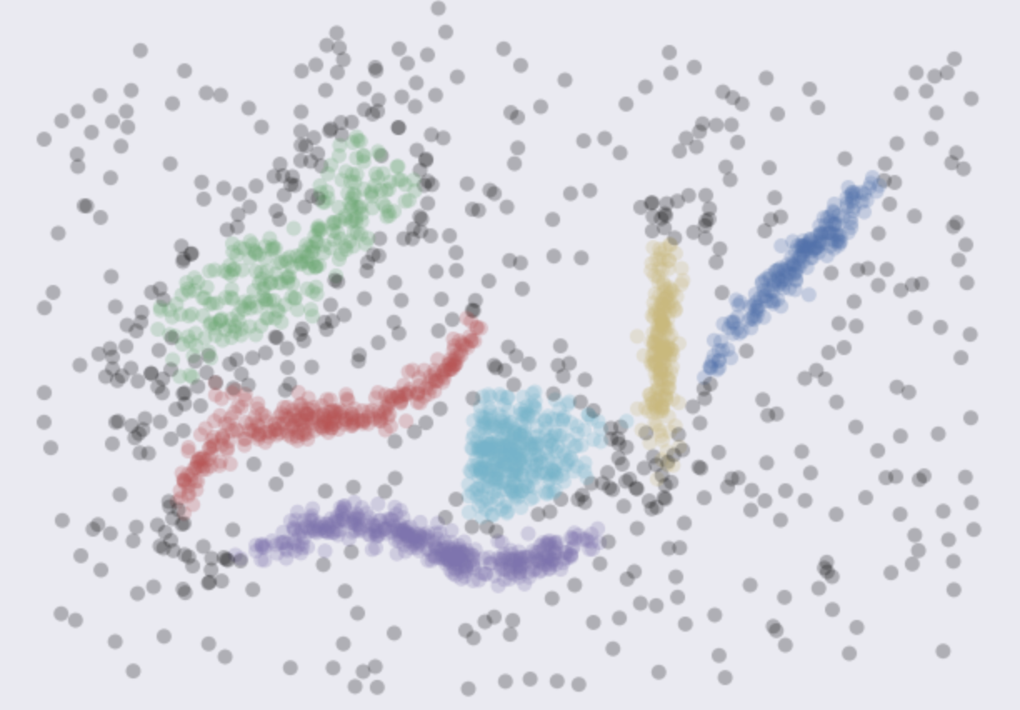
Clustering
Group input documents into known or unknown number of groups based on similarity between them.
Why?
Reduce input size
Discover hidden patterns in your data without any supervision
Visualize these patterns
Example visualization
© taken from lmcinnes github
http://nbviewer.jupyter.org/github/lmcinnes/hdbscan/blob/master/notebooks/Comparing%20Clustering%20Algorithms.ipynb
Notes:
To mention: Clusters of phrases having the same meaning.
Greedy methods
In a nutshell, the algorithm scans the document collection once and assign each document to a new cluster
if there are no other existing clusters that are similar to the current document.
Pros: Scalable;
Cons: Not reliable as it depends on the order;
K-Nearest Neighbors
Each new data point is classified by a majority vote of its (K) neighbors, with the object being assigned to the class most common
among its k nearest neighbors.
Pros: Usually is high on precision; incencitive to outliers; simple;
Cons: Might be very slow for some similarity measures; Might be unstable to the number of K neighbors.
K-Means
K-means partitioning is easy to understand, fast and available method which minimizes intra-partition distances.
If you know number of clusters (for some reasons), just run the algorithms, if not, run the algorithms with multiple number of clusters
as a parameter and see the change if intra-,inter-cluster distances.
In a nutshell, the method have several iteration of the same form, first choose 𝑘 centroid vectors, (*) add all other points to
the centroids that are the closest to them. Then, for each new cluster recompute a centroid (e.g., mean of all vectors), and start over form (*).
Pros: Performance;
Cons: Need to have an intuition on the number of clusters; all points will be assigned to the clusters (even if not all should be there);
Affinity Propagation
This method uses graph-based approach where each point 'votes' on their preferred 'representative'.
The result is a set of clusters of representatives from which we derive clusters and assign each point to the cluster of its nearest representative.
What is good here, we do not need to specifiy the number of clusters here.
Moreover, since we are ignoring the document vector space representations, we could use ay types of similarities
(even those that are not metrics - no triangular property).
Pros: Stable;
Cons: Slow; Hard to find initial parameter right; all points will be assigned to the clusters;
Mean Shift
Similarly to k-means and affinity propagation this method is a centroid based and you do not need to specify the number of clusters.
Moreover, it is an actual clustering algorithms and not partitioning.
The idea of the algorithm is an assumption that there is some generative probability density function from which the data is drawn.
So the method tries to place centroids to the maxima of each density function (kernel density estimation techniques are used).
Pros: Intuitive parameters; does not cluster every point;
Cons: Slow; results vries a lot depending on the bandwidth parameter;
Spectral Clustering
This approach can be considered as an instance of the graph based clustering, where the method considers the eigenvectors of the Laplacian
of the graph in the attempt to find a low-dimentional embeddings of the graphs into Euclidian space
(we assume that the data lies on some kind of manifold, and we try to find the transformation of the original space
into the manifold so that the distances are better represented).
Once we have transformed the space, we run some standart clustering.
Pros: Do not assume globular points clustering (spherical);
Cons: Need to know the number of clusters; might be instable; all points will be assigned to a cluster; slow.
Agglomerative Clustering
The idea behind the family of agglomerative clusterings is that we start with each point being its own cluster and then according to some of the criterion,
we merge clusters. So this process is usually done repeatitively until hierarchy is built.
The benefit of the approach is to be able to inspect dendrogram of clusters to get more information on how those are created.
Again, this approach partition the data rather than cluster it.
Pros: No globular assumption; Stable; Can be relatively fast;
Cons: All data points are assigned to the clusters; need to choose the number of cluters;
DBSCAN
This algorithm belong to the density-based algorithms that does not require all points to be assigned to some cluster.
Clusters are formed based on their densities and sparse regions are left alone as noise.
By the algorithmm points are distinguished as core points, density reachable points and outliers.
A point is a core point if there is at least min N points are within the distance epsilon of it.
Those N points are said to be reachable from core point. Those points could be either directly reachable from the core point (without epsilon distance),
or just reachable (if there is a path between core and that point where each point in the chais is directly reachable from the previous one).
All other points are outliers.
So in a nutshell, we find all neighbors of each point and identify the core points (those with > min N number of neighbors).
Further we find connected components of core points on the neighbor graph, and furhter, each non core point is assigned
to the nearby cluster that is within epsilon distance.
Since the parameters - epsilon and min number of points are static - for datasets with varied densities the approach might miss some of clusters.
Some improvement - HDBSCAN
Pros: Clusters are not globular; not all points are assigned to the clusters; Stable across runs; Relatively fast;
Cons: Parameters are not very intuitive;

Slide 84
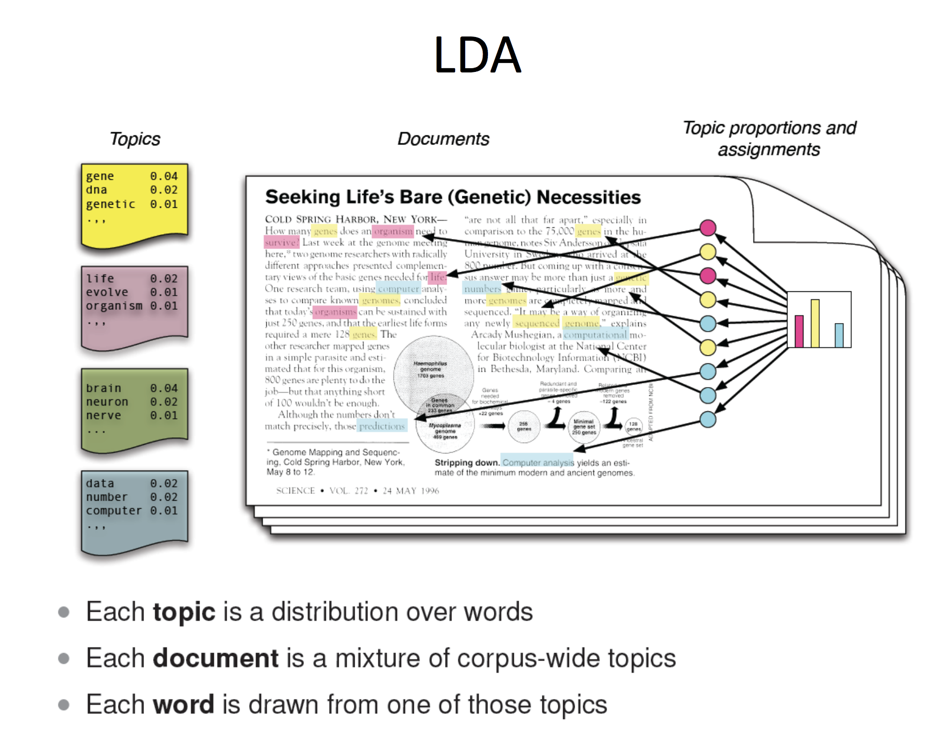
© Whole set of slides here: http://vision.stanford.edu/teaching/cs231b_spring1213/slides/mseg_topics.pdf
Notes:
In particular let's consider one of the most prominent methods: Latent Dirichlet Allocation (LDA).
LDA is a way to automatically discover topics that set of documents convey.
LDA represent documents as mixtures of topics, and each topic somehow generates words with certain probability.
Since we talk about generative models when writing a document:
we need to decide on the number of words N the document will have (this could be some distribution, e.g., Poisson distribution);
further, we need to choose a topic mixture for the document (here we can use Dirichlet distribution over a fixed number of chosen topics K)
now we need to generate each words for each document:
we pick a topic (according to the Dirichlet distribution that we have sampled for the topics)
using picked topics, we generate words (according to the topic's multinomial distribution (models the probability of counts for rolling a k-sided die n times))

Slide 85
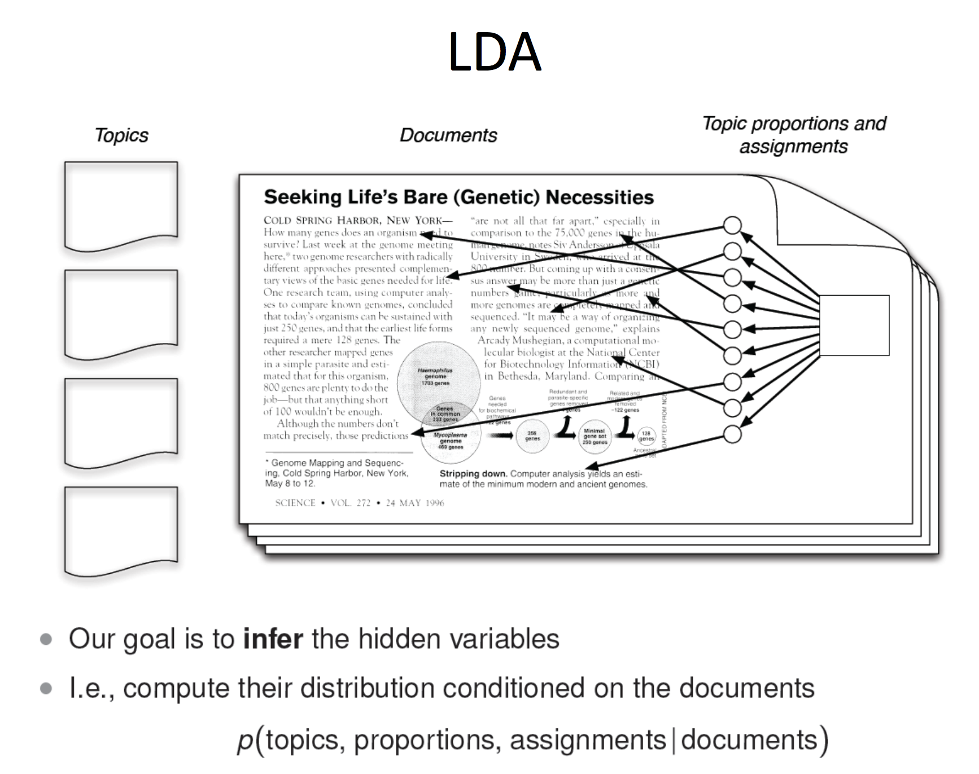

Slide 86
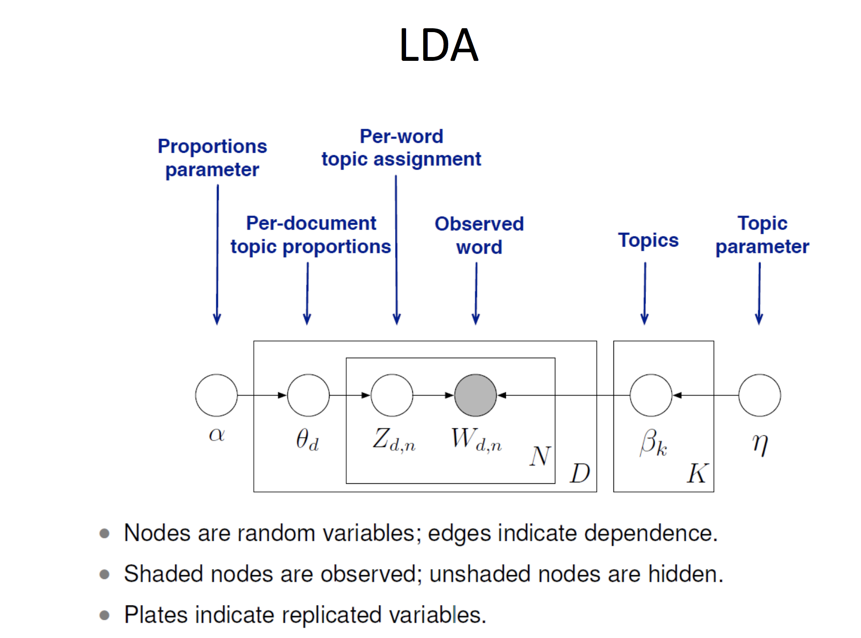

Slide 87
General learning schema
To learn the topic representation of each document and the words associated to each topic:
Go over the documents and assign randomly each word in the topic to one of the K topics
for each document and each word in the document
for each topic t, (1) 𝑝(𝑡𝑜𝑝𝑖𝑐𝑘|𝑑𝑜𝑐𝑢𝑚𝑒𝑛𝑡𝑛) - the portion of words in document 𝑛 that are currently assigned to the topic 𝑘; (2) 𝑝(𝑤𝑜𝑟𝑑𝑖|𝑡𝑜𝑝𝑖𝑐𝑘) - portion of assignments to topic 𝑘 over all documents that come from this word 𝑖.
Reassign word 𝑖 to a new topic, where we choose a topic with probability 𝑝(𝑡𝑜𝑝𝑖𝑐𝑘|𝑑𝑜𝑐𝑢𝑚𝑒𝑛𝑡𝑛)⋅𝑝(𝑤𝑜𝑟𝑑𝑛|𝑡𝑜𝑝𝑖𝑐𝑘) - the probability that topic 𝑘 generated word 𝑖.
Stop once steady
Notes:
(this already gives us both topic and word distribution - though not a good one)
So the assumption with this step, is that all the assignments are correct as they are now, but this one - so we update the words' topic according to the formula above.
http://www.cs.virginia.edu/~hw5x/Course/TextMining-2018Spring/_site/docs/PDFs/topic%20models.pdf

Slide 88
Advanced NLP 1:
Linking text to semantics

Slide 89
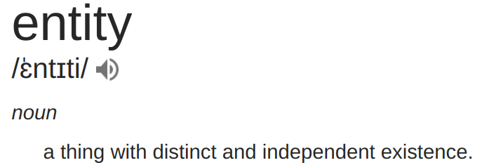
Extracting entities: Linking text to semantics
What are entities?
What are named entities?
From wiki: Named entity is a real-world object, such as persons, locations, organizations, products, etc., that can be denoted with a proper name. It can be abstract or have a physical existence.
Examples: Donald Trump, Paris, Google.

Slide 90
Detecting entities: Subtasks
Named Entity Recognition: Identify where named entities appear in the text, with particular types (e.g. Organization, Location, Person, Time)
Example: flight to Paris/LOC, set alarm at 8am/Time.
Entity Linking (or disambiguation): Match the identity of the entity mentioned in the text to actual entity (defined by non-ambiguous id)
Example: Donald Trump and Trump card.
Coreference resolution: Find all expressions that refer to the same entity in a text.
Example: The food was salty so guests did not enjoy it.
Notes:
Trump card = (in bridge, whist, and similar card games) a playing card of the suit chosen to rank above the others, which can win a trick where a card of a different suit has been led.

Slide 91
Databases of semantic relations
Is-a: the relationship between two entities in which one entity inherits from the other.
Hypernyms are entities with broader/more general meaning,
Hyponyms are entities with narrower/more specific meaning.
Example: iPhone is a phone, phone is an electronic device.
Meronymy denotes a constituent part of, or a member of something. Meronym is a part of a whole!
Example: battery is a part of a smartphone.
Databases: WordNet
Notes:
TODO: Add an example for is-a, clarify that hypernyms are more general concepts/categories, while hyponyms are more specific concepts/categories.
Why want to know? Can be useful to overcome sparse text representations (e.g. extending a term with hypernyms) or to find entailment between texts.

Slide 92
Databases of semantic relations
Synsets denotes synonyms that are interchangeable in some context w/o changing the true value of the statement;
Example: there were done minor or small mistakes.
Metonymy substitution of the name of an attributes for the thing that was meant.
Example: Business executives are in town VS Suits are in town.
Anything
Example: Find who is married to who? What causes what?
Notes:
TODO: Add an example for is-a, clarify that hypernyms are more general concepts/categories, while hyponyms are more specific concepts/categories.
Why want to know? Can be useful to overcome sparse text representations (e.g. extending a term with hypernyms) or to find entailment between texts.
Relation extraction
Methodologies: Regex, Rule based, Wikipedia categories, Distant supervision, Bayesian networks, Factor graphs.

Slide 93
Knowledge Databases and Ontologies
Wikipedia: knowledge about the world; not explicitly structured, but often used as a source of entities in the literature.
DBPedia: mined structured content from Wikipedia
WordNet: lexical database for English, representing different word senses as 'synsets' and also containing synset relations.
OMCS: Commonsense knowledge database, representing human knowledge "The sky is blue". Not easy to mine on the web!
YAGO: is an open source knowledge base developed at the Max Planck Institute.
Notes:
(Yet Another Great Ontology)

Slide 94
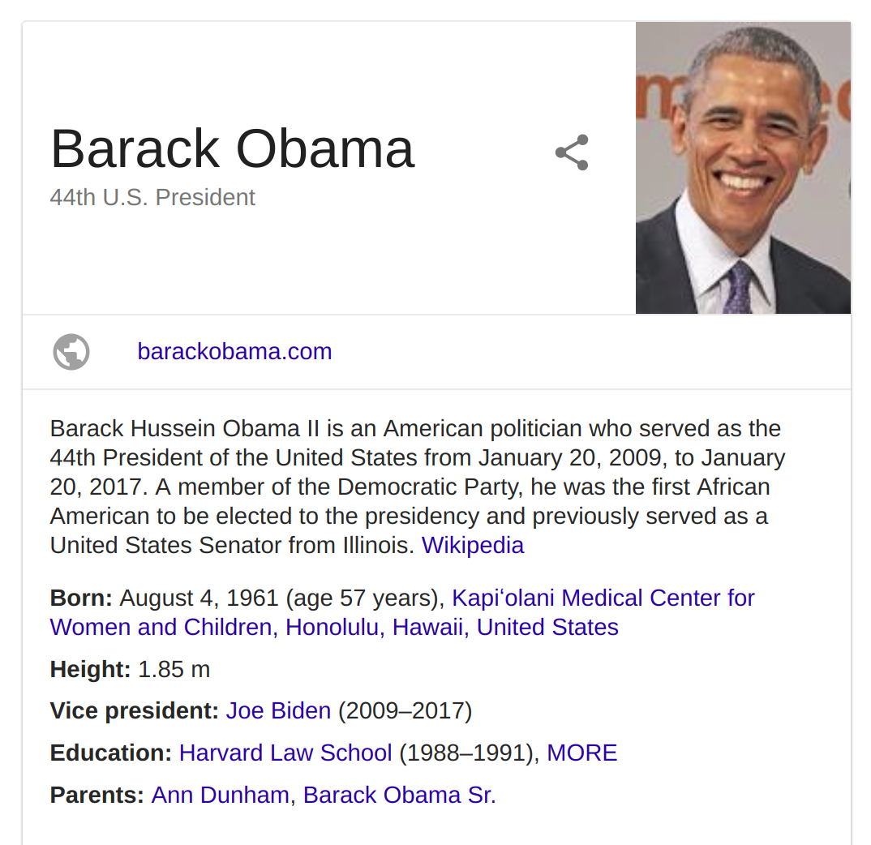
Knowledge Graph
A database of entities and facts (as relations between entities)
Goal: understand/answer factual questions about the world

Slide 95
Entity Linking: Common approach
Annotate text
Find entity candidates by their surface forms (= n-grams of how an entity can appear in the text)
Disambiguate to particular entity based on the context (e.g. co-occurring words)

Slide 96
Advanced NLP 2:
Sequence Modeling

Slide 97
Sequence Modeling (HMM, CRF)
Notes:
TODO(juliapro)

Slide 98
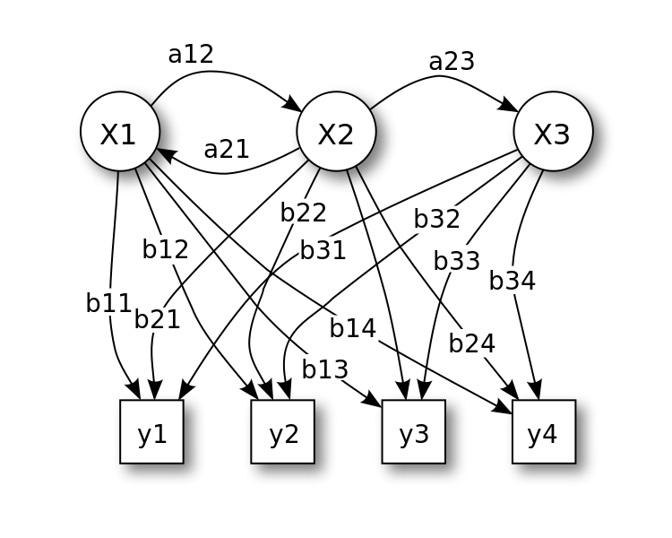
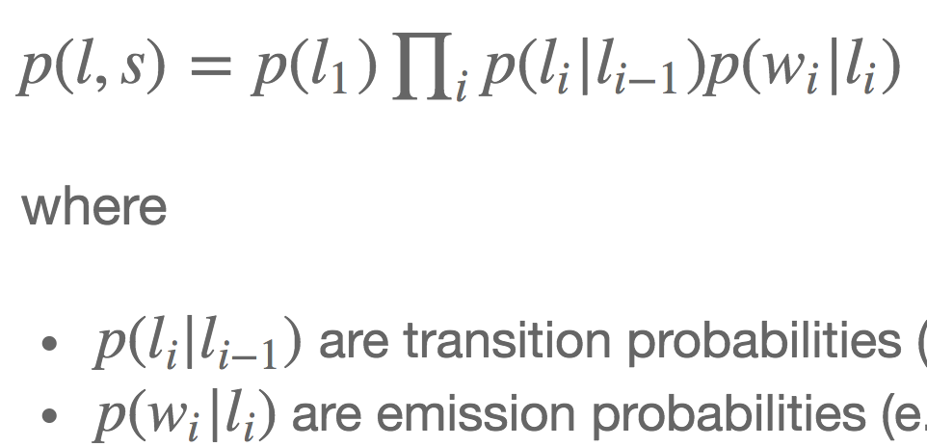
Hidden Markov Models
Notes:
Is a statistical Markov model in which we assume that the process that is being modeled is Markov process
(probability of the event depends only on the previous state/event) with unobserved states.
So in the Markov process the states are directly observed, thus, we have only state transition probabilities.
In the *Hidden Markov Model* the state is not directly visible, but the output
(dependent on the state) is visible. Thus, each state has a probability distribution over the possible output tokens.
HMM are well known and used for the following applications: part of speech tagging, reinforcement learning and temporal pattern recognition
(speech, handwriting, gestures, etc.), bioinformatics, etc.
HMM can be seen as a generalization of a mixture model where the hidden variables are related through
a Markov process rather than independent (as we have seen in the Topic Modeling).
For example, consider part-of-speech tagging problem, where POS are the hidden states that have some observed word representation.
As a result, we need the entire sequence of the states to be computed - Viterbi algorithm
(dynamic programming + backtracking) can be used.

Slide 99
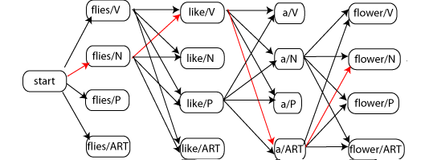
Hidden Markov Models
POS example:
Notes:
Is a statistical Markov model in which we assume that the process that is being modeled is Markov process
(probability of the event depends only on the previous state/event) with unobserved states.
So in the Markov process the states are directly observed, thus, we have only state transition probabilities.
In the *Hidden Markov Model* the state is not directly visible, but the output
(dependent on the state) is visible. Thus, each state has a probability distribution over the possible output tokens.
HMM are well known and used for the following applications: part of speech tagging, reinforcement learning and temporal pattern recognition
(speech, handwriting, gestures, etc.), bioinformatics, etc.
HMM can be seen as a generalization of a mixture model where the hidden variables are related through
a Markov process rather than independent (as we have seen in the Topic Modeling).
For example, consider part-of-speech tagging problem, where POS are the hidden states that have some observed word representation.
As a result, we need the entire sequence of the states to be computed - Viterbi algorithm
(dynamic programming + backtracking) can be used.
HMM - https://www.slideshare.net/marinasantini1/lecture-7-hidden-markov-models-hmms Maybe http://users-cs.au.dk/cstorm/courses/PRiB_f12/slides/hidden-markov-models-1.pdf
CRF - https://www.slideshare.net/lswing/conditional-random-fields

Slide 100
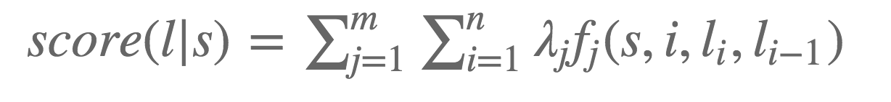

Conditional Random Fields
Feature function is a function that takes in as input:
a sentence s
the position i of a word in the sentence
the label Li of the current word
the label Li-1 of the previous word
So given a sequence s we can now score it as follows:
Arbitrary features can be also added on top :)
Notes:
Is also a statistical modeling method that is usually applied for structured prediction (predict the sequence of labels; parsing; named entity recognition,
shallow parsing, etc.).
CRF is a discriminative undirected probabilistic graphical models which somehow encodes known relationships between observations and construct consistent interpretations.
CRF is defined on top of observations X and random variables Y.
In particular, in conditional random field (X, Y) - random variable Y that is conditioned on X follows Markov property (memoryless).
In the context of CRFs, we are defining feature functions that takes as input:
(1) sentence, (2) position of the word, (3) label of the i-th word, (4) label of the previous word - and outputs a real value (feature value).
We can convert those features and feature scores to the probabilities by using exponentiation and normalization.
Label sequence modeled as a normalized product of feature functions.
In order to express probability 𝑃(𝑦|𝑥,𝑤) of the sequence through the feature functions, exponentiation is used.
To learn the weights of the features, we need to compute the gradient of the log probability p(labels | sentence).
Two options are possible once it comes to the inference over CRFs, either the graph is a chain or tree - then we can use HMM algorithms,
or if the graph contains loops.

Slide 101


Slide 102
Sequence Modeling
Motivation: Why Sequence Models?
Recurrent Neural Networks: Overview
Recurrent Neural Network Architectures
Types of RNN Cells
Notes:
Review agenda for module:
Motivation - Why Sequence Models?
Recurrent Neural Networks - Overview - RNNs are the main tool we use for sequential models.
Recurrent Neural Network Architectures
Types of RNN cells

Slide 103
Outline
Motivation: Why Sequence Models?
Recurrent Neural Networks: Overview
Recurrent Neural Network Architectures
Types of RNN Cells
Notes:
Motivation: Why Sequence Models?

Slide 104
Feed Forward Networks
Notes:
Feed forward networks
Why do we care?
What do we need to know about sequential models?
Feed forward Neural Network:
https://medium.com/@xtaraim/a-very-basic-introduction-to-feed-forward-neural-networks-97a33b34604f

Slide 105
Feed Forward Networks
input layer
Notes:
Input layer(s) at the bottom...

Slide 106
Feed Forward Networks
hidden layers
input layer
Notes:
Hidden layers - some hidden layers in the middle...

Slide 107
Feed Forward Networks
output layer
hidden layers
input layer
Notes:
Output layer - output layers at the top/end. Going to have whatever prediction you care about here.

Slide 108
Feed Forward Networks
Fixed size layers
Notes:
Fixed size layers - everything in this feed forward network is of fixed size.
The inputs need to be of the same size, no matter what I feed into it.
We can do things like change the batch size, but that is really things that go through it, not how big the actual network is.

Slide 109
Feed Forward Networks
Fixed size layers
Inference is stateless
Notes:
Inference is stateless - completely stateless. Once done with training, freeze the weights.
Any example I feed through it isn’t going to go through it once and it’s not going to modify it afterwards.

Slide 110
Feed Forward Networks
Fixed size layers
Inference is stateless
Nodes are unordered
Notes:
Nodes are unordered - any node within a given hidden layer is identical to each other.
There is no ordering at all going on here.

Slide 111
Language as Input
Input to a language model can have variable length. For example,
what | do | you | want | to | drink | now | ?
two | old | fashioned | please
Notes:
Language as input - feedforward networks are very useful, you have been using them for a while and you are able to do good things with them.
If you have something that is variable input then you have to convert it to make it a fixed length input.

Slide 112
Language as Input: the “Typical” Approach
what | do | you | want | to | drink | now | ?
two | old | fashioned | please
Notes:
Example: Let’s say you have sentences that you want to feed into the network.
This is a typical approach - you might remember the movie review example from the embeddings exercise in MLCC.

Slide 113
Language as Input: the “Typical” Approach
Words are embedded independently
Embedding
what | do | you | want | to | drink | now | ?
two | old | fashioned | please
Notes:
Words are embedded independently - take these sentences, and you would embed each word independently.

Slide 114
Language as Input: the “Typical” Approach
Embeddings are aggregated using sum or average
Aggregation
Embedding
what | do | you | want | to | drink | now | ?
two | old | fashioned | please
Notes:
Embeddings are aggregated using sum or average - figure out some aggregation strategy that embeds those at a fixed length.

Slide 115
Language as Input: the “Typical” Approach
Yielding vectors of fixed size
Aggregation
Embedding
what | do | you | want | to | drink | now | ?
two | old | fashioned | please
Notes:
Yielding vectors of fixed size - if you can aggregate these embeddings and get them into a fixed length, then you can use that fixed length to feed into our fixed length network.

Slide 116
Language as Input: the “Typical” Approach
This is essentially the “bag-of-words” approach
Aggregation
Embedding
what | do | you | want | to | drink | now | ?
two | old | fashioned | please
Notes:
This is essentially the “bag of words” approach:
Take everything, regardless of position, in the sentence, aggregate it all together, and now we have single embedding that represents the whole sentence, over all of the terms.

Slide 117
Bag of Words: Pros and Cons
Pro: Allows variable length data to be fed into a typical feed-forward network.
Pro: Variable length features can easily be combined with fixed length features.
Pro: Widespread empirical success.
Notes:
Bag of Words Pros
Pretty good actually.
Can handle variable length data (doesn’t matter how many words sentence has).
Feed it into a traditional FF network.
Attach onto this embedding (see previous slide).
If we have other features we can keep tracking them on here.
We can include multiple variable or fixed length features. All can go and be fed into the network together.
We see empirical success, in practice. (Example: movie reviews).
Bag of words is faster, simpler than RNN.
Usually works.
You should try this before moving on to more difficult models because it can be effective and fast.
This can affect things like latency and how difficult it is to train the model and interpret.

Slide 118
Bag of Words: Pros and Cons
Pro: Allows variable length data to be fed into a typical feed-forward network.
Pro: Variable length features can easily be combined with fixed length features.
Pro: Widespread empirical success.
Con: Destroys the structure of the input:
The cat sat on the mat != {cat, sat, the, the, mat, on}
Notes:
Bag of Words Cons:
Destroys our input. - the input was in a nice logical order.
Have now said that sentence is now the same as that set of words.
That’s just the nature of what bag of words does with the aggregation function. Aggregation function is completely agnostic to what the order was in the sentence.
This can cause problems because the set of words doesn’t contain all of the information that we have syntactically in our sentence.

Slide 119
Structure and Ordering is Important
For example:
Humor or sarcasm
Modifiers such as somewhat, extremely or not
Multi-word phrases such as tiger mosquito or zurich city bridge
Notes:
Structure and Ordering is important.
Can be very important for Humor or sarcasm which can rely on a play on words
Obvious example are modifiers. Things like “not” - if you put not in front of a word, it completely changes its meaning.
Also applies to some multi-word phrases like “jumbo shrimp” and “forest city bridge”. You can imagine with “forest city bridge” using the bag of words approach.
It will take things that have very different meanings from each other and will try to average that out across those words. In this case, if you had some idea of the ordering, you would be better off.

Slide 120

Big Idea of Recurrent Neural Networks
Let’s wrap a DNN in a for loop!
Notes:
Recurrent Neural Networks: Overview - Let’s take our “giant hammer” of DNNs (deep neural networks), and put it in a for loop.

Slide 121

Recurrent Neural Nets: A Cell...
output, end_state =
rnn_cell(input, start_state)
output y_{t}
RNN Cell h_{t}
start state h_{t-1}
end state h_{t}
input x_{t}
Notes:
Here is some pseudocode.
RNN: A Cell - this is going to look a lot like neural net cells you’ve seen before.
Going to have an input and an output, the big difference is that we are going to have an extra thing we feed in: a state.
Both an input state (start) and an output state (end). We want to label/add these states with one constraint.

Slide 122
Recurrent Neural Nets: A Cell...
The only rule:
start state and end state must have the same dimension.
output
RNN Cell
start state
end state
input
Notes:
Feed in the current input and a basic state.
The only rule: start state and end state must have the same dimension, same set of floating point numbers that we feed in and out. Require that they are the same.

Slide 123
Recurrent Neural Nets: A Cell...Wrapped in a For Loop
for i in range(sequence_length):
output[i], end_state =
rnn_cell(input[i], start_state)
start_state = end_state
output
RNN Cell
input
Notes:
Stitch them together. Whatever gets passed out as the state, feed it in at the next timestep.
This is the for loop that’s going on here, you can see it in pseudocode on the side, where for every term in our sequence, we’re going to run this RNN cell once. And for each term, we are going to run it, we’re going to feed in the current input and some initial state at the first time step, and then get an output and a new state which is fed in at the next time step.
The idea is that the network is going to learn what sorts of information it needs to be passing along at that state at every time step for it to be doing a good job on its prediction task.
So, we’re putting a loop around a normal network and remembering some things to feed in at future time steps, allowing the network to figure out what it should be remembering.

Slide 124
Recurrent Neural Nets: Unrolling the For Loop
output
output[0]
output[1]
output[2]
RNN Cell
=
start state
end state
input[0]
input[1]
input[2]
input
Notes:
Unrolling the For Loop
In this diagram, we will look inside the RNN cell (left), and unroll the for loop, to represent it on the right.
We feed in different input at every time step (each box), get a different output at every time step, and pass straight from left to right. The state will propagate along from one time step to another.
Again, this is a visual representation with the for loop unrolled, which helps us visualize the inside of the RNN cell.

Slide 125
Recurrent Neural Nets: Unrolling the For Loop
Each cell is identical and they share weights.
output[0]
output[1]
output[2]
H
H
H
start state
end state
input[0]
input[1]
input[2]
Notes:
Each cell is identical and they share weights.
In reality, one cell, one set of weights that you’re learning.
Learning single function that you’re applying over and over again to parts of the input at a time.

Slide 126
Recurrent Neural Nets: Unrolling the For Loop
Each cell is identical and they share weights.
When we train an RNN, we are really training a single cell that is used repeatedly.
output[0]
output[1]
output[2]
H
H
H
start state
end state
input[0]
input[1]
input[2]
Notes:
Because it is wrapped in a for loop, you are training a single cell repeatedly in an RNN. The outputs you care about depend on the problem you’re modeling.
Pause here for questions.

Slide 127




Recurrent Neural Nets: Error computation
label[0]
label[1]
label[2]
Total cost F
cost₀
cost₁
cost₂
output[0]
output[1]
output[2]
H
H
H
start state
end state
input[0]
input[1]
input[2]

Slide 128
Outline
Motivation: Why Sequence Models?
Recurrent Neural Networks: Overview
Recurrent Neural Network Architectures
Types of RNN Cells
Notes:
Recurrent Neural Network Architectures - let’s talk about a few different ways that you can set up the inputs and the outputs.

Slide 129

Types Of NNs
Taken from [2].
Notes:
Ask students: “Can someone provide an example for one of these types?”
Different types of Neural Networks
Standard FF DNN, no recurrence (e.g., image classification)
RNN: Sequence output (e.g., take image, output caption)
RNN: Sequence input (e.g., take sentence, output sentiment classification)
RNN: Sequence to Sequence (e.g., machine translation, speech recognition)
RNN: Synced classification (e.g., classify every video frame)

Slide 130
RNN Architectures: Many to Many
Example: speech recognition
Input: windowed audio
Output: sequence of letters
Notes:
Many to Many (one direction):
My loss function is applied to each output/node individually.
For something like this I can evaluate each node and know whether I am correct or not.
Ask students: Does anyone have an example of another problem that would predict the many to many configuration?
(canvas students for answers)

Slide 131

RNN Architectures: Example
We
like
the
summer
P(“We” | <s>)
P(“like” | <s>, we)
P(“the” | <s>, we, like)
P(“summer” | <s>, we like, the)
the
a
and
the
cat
a
dog
and
the
hat
cat
a
runs
dog
and
the
pig
hat
cat
a
...
runs
dog
and
...
pig
hat
cat
...
runs
dog
...
pig
hat
...
runs
...
pig
...
...
h₁
h₂
h₃
h₄
h₀
embedding
embedding
embedding
embedding
<s>
We
like
summer

Slide 132
RNN Architectures: Many to One
Example: spam filtering
Input: words in an email
Output: spam or not spam
Notes:
Many to One
Multiple inputs and produce a single output.
One example: sentiment analysis.
Feed in a whole bunch of words (e.g., movie review), output - was it a positive or negative review?
Since we are making a single prediction across an entire body of text, we can wait until the last time step to produce a prediction.
Spam filtering example. Read entire email and only after reading whole thing do we decide if it is spam or not spam. Might need a lot of memory for a lot of time steps; this will be covered later.
Ask students for any additional examples of many-to-one problems
(canvas students for answers)

Slide 133
RNN Architectures: Many to One
Example: spam filtering
Input: words in an email
Output: spam or not spam
Notes:
Many to One
Multiple inputs and produce a single output.
One example: sentiment analysis.
Feed in a whole bunch of words (e.g., movie review), output - was it a positive or negative review?
Since we are making a single prediction across an entire body of text, we can wait until the last time step to produce a prediction.
Spam filtering example. Read entire email and only after reading whole thing do we decide if it is spam or not spam. Might need a lot of memory for a lot of time steps; this will be covered later.
Ask students for any additional examples of many-to-one problems
(canvas students for answers)

Slide 134
RNN Architectures: Example
the
a
and
cat
dog
hat
runs
pig
...
...
h₁
h₂
h₃
h₄
h₀
embedding
embedding
embedding
embedding
<s>
We
like
summer

Slide 135
RNN Architectures: Sequence to Sequence
Example: translation
Input: Spanish
Output: Mandarin
Notes:
Sequence to Sequence: example - translation
Read all inputs until inputs exhausted.
Read outputs, all outputs get compared against my labels and that creates my loss function.
Walk through translation example
Take individual words, embed them into floating point representation.
Feed that into network at every time step, output will be probability distribution over the words in vocab that we care about.
Pick a set of words as output to use (e.g., output will be top million most commonly used words in language; large softmax, but tools like candidate sampling/sample softmax make it more efficient).
Thing to think about, at inference time, how to make sure outputs are coherent, use beam search to keep top/most likely candidates.

Slide 136
RNN Architectures: Sequence to Sequence
We often use different cells for encoding and decoding.
Notes:
Sequence to Sequence continued
We don’t know how long output is going to be, so keep generating output tokens until end of sentence token.
What if we don’t produce an end? When do I want to terminate? Use maximum length of allowed prediction, or stop generating when probability falls below certain threshold.
In a generative model that doesn’t terminate, can look like “hallucinations” or gibberish, at some point might look like Markov Model
More common to use a different set of weights in the input stage and the output stage.
Can combine CNNs with RNNs
Can have bi-directional RNN when you feed sentences in forward and backwards
If questions about Translate come up, you can refer students to blog posts:
https://research.googleblog.com/2016/09/a-neural-network-for-machine.html
https://research.googleblog.com/2016/11/zero-shot-translation-with-googles.html

Slide 137

Conditional LM
Notes:
How do we encode the input or consition?

Slide 138

Encoder

Slide 139
RNN Architectures: Example
Condition
We
like
the
summer
P(“We” | <s>)
P(“like” | <s>, we)
P(“the” | <s>, we, like)
P(“summer” | <s>, we like, the)
the
a
and
the
cat
a
dog
and
the
hat
cat
a
runs
dog
and
the
pig
hat
cat
a
...
runs
dog
and
...
pig
hat
cat
...
runs
dog
...
pig
hat
...
runs
...
pig
...
...
h₁
h₂
h₃
h₄
h₀
embedding
embedding
embedding
embedding
<s>
We
like
summer

Slide 140

RNN Architectures: Beam Search
Notes:
RNN Architecture: Sequence to Sequence
Another example of language modeling: feed in words one by one, at some point, an end token will represent that you are done reading input
Feed W (“start”) into decoder, decoder learns to produce outputs

Slide 141

RNN Architectures: Beam Search
Notes:
RNN Architecture: Sequence to Sequence
Another example of language modeling: feed in words one by one, at some point, an end token will represent that you are done reading input
Feed W (“start”) into decoder, decoder learns to produce outputs

Slide 142

RNN Architectures: Beam Search
Notes:
RNN Architecture: Sequence to Sequence
Another example of language modeling: feed in words one by one, at some point, an end token will represent that you are done reading input
Feed W (“start”) into decoder, decoder learns to produce outputs

Slide 143

RNN Architectures: Beam Search
Notes:
RNN Architecture: Sequence to Sequence
Another example of language modeling: feed in words one by one, at some point, an end token will represent that you are done reading input
Feed W (“start”) into decoder, decoder learns to produce outputs

Slide 144

RNN Architectures: Beam Search
Notes:
RNN Architecture: Sequence to Sequence
Another example of language modeling: feed in words one by one, at some point, an end token will represent that you are done reading input
Feed W (“start”) into decoder, decoder learns to produce outputs

Slide 145

RNN Architectures: Beam Search
Notes:
RNN Architecture: Sequence to Sequence
Another example of language modeling: feed in words one by one, at some point, an end token will represent that you are done reading input
Feed W (“start”) into decoder, decoder learns to produce outputs

Slide 146

RNN Architectures: Beam Search
Notes:
RNN Architecture: Sequence to Sequence
Another example of language modeling: feed in words one by one, at some point, an end token will represent that you are done reading input
Feed W (“start”) into decoder, decoder learns to produce outputs

Slide 147

RNN Architectures: Beam Search
Notes:
RNN Architecture: Sequence to Sequence
Another example of language modeling: feed in words one by one, at some point, an end token will represent that you are done reading input
Feed W (“start”) into decoder, decoder learns to produce outputs

Slide 148

RNN Architectures: Sequence to Sequence
Source
Notes:
RNN Architecture: Sequence to Sequence
Feed W (“start”) into decoder, decoder learns to produce outputs
BUT!!!
We are compressing a lot of information in a finite-sized
vector.
Gradients have a long way to travel.
• Represent a source sentence as a matrix
• Generate a target sentence from a matrix
• This will
• Solve the capacity problem
• Solve the gradient flow problem

Slide 149

Sentences as matrices

Slide 150

Sentences as matrices

Slide 151

Sentences as matrices

Slide 152

Sentences as matrices

Slide 153


Slide 154


Slide 155

Attention

Slide 156

Attention

Slide 157

Attention

Slide 158

Attention

Slide 159

Attention

Slide 160

Attention

Slide 161

Attention

Slide 162

Attention

Slide 163

Attention

Slide 164

Attention

Slide 165

Attention

Slide 166

Attention

Slide 167

Attention

Slide 168

Attention

Slide 169

Attention

Slide 170
Outline
Motivation: Why Sequence Models?
Recurrent Neural Networks: Overview
Recurrent Neural Network Architectures
Types of RNN Cells
Notes:
Type of RNN Cells: there are several ways you can set up your input, but let’s talk about what’s happening inside the cell.

Slide 171

Simple RNN Cell Example
Taken from http://colah.github.io/posts/2015-08-Understanding-LSTMs/ [3].
Notes:
Input calibration
x(t), h(t) are vectors of floats
Simple RNN Cell Example
We can put a single neural net layer here, where each box represents a hidden layer.
Take in the input, combine it with the output state of previous step and concatenate it into the neural network layer.
Remember that output is also our state in a simple RNN, so we pass along output and feed it in at next time step.
In a language modeling problem. h_{t} would get fed into a softmax produces probability distribution.
h_{t} could be a small number of floats compared to what you are predicting
tanh is just an example, you could put a sigmoid there, or a ReLU.
Reference for http://colah.github.io/posts/2015-08-Understanding-LSTMs/

Slide 172

Problem: Vanishing Gradients
Taken from [3].
Notes:
Problem: Vanishing Gradients - RNNs are notoriously difficult to train.
The problem is what is fed in at time step 0 & 1 affected what I should have predicted at later time step.
When doing backpropagation, need to carry signal all the way back.
Should have kept something more in the state for me in earlier time steps. Depending on how long the dependency is, it is hard to get the gradient to go back to the input. Called vanishing gradient.

Slide 173
Problem: Vanishing Gradients
Using simple RNN cells, the model has difficulty learning connections between inputs and outputs that are far apart.
Taken from [3].
Notes:
Gradients exploding → start to see infs and NaNs in gradients during training.
Gradients vanishing → gradients from t+T to t go to 0 for large T; can’t learn long term dependencies.
Ask people: How would you address these 2 problems?
(canvas students for answers)

Slide 174
Problem: Vanishing Gradients
In other words, your model has very small gradients.
Taken from [3].

Slide 175
Problem: Vanishing Gradients
Gradients from t+T at time t vanish exponentially with T if at each time step |dh(t)/dh(t-1)| < 1.0
Taken from [3].
Notes:
Longer term dependencies get progressively harder to learn.
Gradients vanish exponentially if the dependency of our outputs on the previous state is less than 1.
Tanh or sigmoid where the derivative is always less than 1; for every timestamp, it will get smaller until you entirely lose that signal.

Slide 176
Problem: Vanishing Gradients
In other words, your model has very small gradients.
It will learn extremely slowly.
Taken from [3].
Notes:
Very small gradients will learn and make inferences notoriously slowly. RNNs are slow for training as well.
Using simple RNN cells models has difficulty learning connections between inputs and outputs that are far apart
Very small gradients
Exponential vanishing
Very small gradients = extremely slow learning

Slide 177
Problem: Gradients Exploding
Opposite issue! Start to see NaNs during training
Taken from [3].
Reference: On the difficulty of training recurrent neural networks
Notes:
Problem: Gradients exploding
Opposite issue, start to see infs and NaNs in gradients during training
Compare to Gradients vanishing → gradients from t+T to t go to 0 for large T; can’t learn long term dependencies.
Ask people: How would you address these 2 problems?
(canvas students for answers)

Slide 178

A solution: Long Short Term Memory Cells
Taken from [3].
Notes:
…But first let’s see how LSTMs are defined.
Solution: Long Short Term Memory (LSTM) Cells
Probably most common/popular RNN architecture, very powerful.
Define LSTM - LSTM is an empirical discovery.
Explanation of how this works is retrospective / rather than explaining *why* it works.
Don’t worry about trying to derive this. We will give you intuition for what these components of the LSTM are doing and how they work.

Slide 179

A solution: Long Short Term Memory Cells
Taken from [3].
Notes:
…But first let’s see how LSTMs are defined.
Cover notation
Neural network layers (yellow box)
Pointwise operations (pink circle)
Arrows represent output flow
Branching arrows: data flowing in different directions
Arrows coming together: concatenation

Slide 180

LSTM - Cell State
“Conveyer belt”
LSTM can “add” or “remove” information to cell state via gates.
Taken from [3].
Notes:
Here is the main part of the LSTM, the equivalent of a memory cell in a standard computer.
LSTM - Cell State - called LSTM because there is opportunity to remember things long term or short term.
Long term memory is in the “conveyor belt” - part of our state.
You have the opportunity to add or remove things at every time step.
Can put things to remember for a long period of time (no activation functions).
LSTM can add or remove information to cell state via gates (pointwise operations).

Slide 181


Gates: Optionally Let Information Through
Element-wise sigmoid and element-wise multiplication
Differentiable: trainable
Taken from [3].
Notes:
Sigmoid:
A value of zero means “let nothing through,” while a value of one means “let everything through!”
Let’s the information through the gate
It’s continuous.
Selectively pass parts of the state forward; selectively pass gradients back.
Selection depends on input and state.
Learn which parts to select.
Gates: Optionally Let Information Through
Think of this element-wise multiplication as a “forget gate.”
What’s going to be fed through this element-wise multiplication is output of sigmoid.
Output of sigmoid between 0 - 1.
Will forget some fraction of the information of everything along the conveyor belt.
Can drop things off belt quickly if we do not need them.

Slide 182

LSTM Cell: Forget Gate
Taken from [3].
Notes:
LSTM: Forget Gate - Will hit some of that element-wise multiplication and knock out some of those terms.

Slide 183

LSTM Cell: Input Gate and Candidate State
?
Taken from [3].
Notes:
LSTM: Input Gate and Candidate State
Input gate i_{t}: here, we decide what we’re going to add to our network
C_{t}: Candidate state, a proposed set of things we may want to add to our conveyor belt.
Get it by taking input and second component of our state (h_{t}), combine these together and this will go into a sigmoid and tanh.
What gets produced by tanh, a hidden layer, will create some floating point representation of proposed modification of our state.
Another sigmoid into element-wise multiplication will determine what parts of the state will pass through, and some of the candidate state gets passed along.

Slide 184

LSTM Cell: Update the Cell State
?
Taken from [3].
Notes:
LSTM Cell: Update the Cell State
I_{t,.}which comes from sigmoid, multiplies to candidate state, to let certain parts through, and decides what gets through and gets added to the conveyor belt.
Steps:
Step 1: forget part of previous state.
Step 2: add candidate state.

Slide 185


LSTM Cell: Output Gate
Output filtered version of cell state
?
Taken from [3].
Notes:
LSTM Cell: Output Gate
Here, we take things off the conveyor belt. Put through an element-wise tanh, and do a pointwise multiplication against it to select element to read from conveyer belt.
Use a sigmoid dependent on input, choose which terms you want, extract them as output, pass those both at the time step and as new h_{t} at next time step.
Output filtered version of cell state (what’s on conveyor belt)

Slide 186
LSTM Cell: Take Away
LSTM cells propagate state on a ‘conveyor belt.’
LSTM cells contain a series of gates that alter state at each time step.
Some gates add to the state while other gates forget.
LSTM cells can propagate information over many time steps.
They can also erase state quickly.
Taken from [3].
Notes:
LSTM Cell: Take Away - what you should remember
LSTM cells propagate/maintain state on a “conveyor belt,” making them good at remembering things over many time steps.
Forget gates allow new things to be remembered
Pause for questions on LSTMs: ask students if any concepts are unclear.

Slide 187
Empirical results
LSTM is probably the most popular, but:
People use different variations of LSTM, gated recurrent units (GRU), etc.
Notes:
Empirical Results: LSTMs do well in practice
However, they are very very slow. RNNs are slow, LSTMs are even slower.
You can train it really well but can't launch it into production because of latency concerns.
Remember rule of baselines:
Try bag of words first, then
Try a simple RNN, then a
Simple LSTM to see if you can get a quality win

Slide 188
RNN Cells In TensorFlow
https://www.tensorflow.org/tutorials/recurrent
Notes:
RNN Cells in TensorFlow
For more information and a tutorial on RNNs, take a look at this page on tensorflow.org.

Slide 189

Convolutional Neural Networks
http://deeplearning.stanford.edu/wiki/images/6/6c/Convolution_schematic.gif
Notes:
Image can become blurred or edgy or whatever

Slide 190

CNN
Kim, Y. (2014). Convolutional Neural Networks for Sentence Classification

Slide 191

Convolutional
Neural Networks
on Text
Source: http://www.wildml.com/2015/11/understanding-convolutional-neural-networks-for-nlp/

Slide 192

Convolutional Neural Networks on Text Narrow vs Wide Convolution
Narrow vs. Wide Convolution. Filter size 5, input size 7. Source: A Convolutional Neural Network for Modelling Sentences (2014)

Slide 193

Convolutional Neural Networks on Text Stride Size
Convolution Stride Size. Left: Stride size 1. Right: Stride size 2. Source: http://cs231n.github.io/convolutional-networks/

Slide 194

Convolutional Neural Networks on Text Pooling Layers
Max pooling in CNN. Source: http://cs231n.github.io/convolutional-networks/#pool

Slide 195
Convolutional Neural Networks on Text Channels
RGB for images
Word2Vec, Glove, etc for text

Slide 196
Case Studies
SmartReply
Text Simplification and its evaluation

Slide 197
All the best!
Feel free to ask me anything related to Google, NLP, ML, DL, PhD, Career, Online Activism, Sport :)
me@juliapro.xyz

